Slide 1
Notes:
Pupils might have seen people wearing poppies. Do they know why this is?
The poppy is a symbol of hope and peace. It reminds us about the service and sacrifice of the men and women all over the world who have fought in wars so that we can keep our way of life.
At 11am on the 11th November 1918, the First World War ended. For this reason, we are silent for two minutes at 11am on 11th November every year so that we can remember the people who have served our country in that war and all the wars since then.
As well as wearing poppies and having a one minute silence, there are other ways we can remember. Does anyone know what these might be?
The images represent: a two minute silence, wearing a poppy, attending a remembrance service, visiting a war memorial, finding out about your family’s connection to service

Slide 2
I
I
I
Notes:
Students might have seen people wearing poppies. Do they know what the poppy symbolises?
The poppy is a symbol of hope and peace. It reminds us about the service and sacrifice of the men and women all over the world who have fought in wars so that we can keep our way of life.
At 11am on the 11th November 1918, the First World War ended. For this reason, we are silent for two minutes at 11am on 11th November every year so that we can remember the people who have served our country in that war and all the wars since then.
As well as wearing poppies and having a two minute silence, there are other ways we can remember. Discuss the images and encourage students to share ways they remember.
The images represent: a two minute silence, wearing a poppy, attending a remembrance service, visiting a war memorial, finding out about your family’s connection to service

Slide 3
We will remember them all.
Notes:
This year marks the 75th anniversary of three important battles that took place during WWII:
Monte Cassino (17th January to 18th May 1944) fought in Italy
D-Day (6th June 1944) fought in France
Imphal and Kohima (8th March to 18th July 1944) fought in India

Slide 4
Remember Together
WWII was the biggest war the world has ever seen. The UK couldn’t have won the war alone, we worked with our allies.
Does anybody know which countries fought alongside us in WWII?
Notes:
Explain the term ‘ally’: a country who works with another country to solve a problem.
See whether students know or can guess some of the countries who were our allies in WWII. In total, 46 countries signed a document agreeing to work together in WWII:
Australia
Belgium
Bolivia
Brazil
Canada
Chile
China
Colombia
Costa Rica
Cuba
Czechoslovakia (now Czech Republic and Slovakia)
Dominican Republic
Ecuador
Egypt
El Salvador
Ethiopia
France
Greece
Guatemala
Haiti
Honduras
Pre-partition India (now India, Pakistan and Bangladesh)
Iran
Iraq
Lebanon
Liberia
Luxembourg
Mexico
Netherlands
New Zealand
Nicaragua
Norway
Panama
Paraguay
Peru
Philippines
Poland
South Africa
Soviet Union (now 15 countries: Armenia, Moldova, Estonia, Latvia, Lithuania, Georgia, Azerbaijan, Tajikistan, Kyrgyzstan, Belarus, Uzbekistan, Turkmenistan, Ukraine, Kazakhstan, and Russia)
Syria
Turkey
United Kingdom
United States
Uruguay
Venezuela
Yugoslavia (now Bosnia and Herzegovina, Croatia, Macedonia, Montenegro, Serbia, Slovenia)

Slide 6
Notes:
Monte Cassino was a monastery located on a hill over the town of Cassino in southern Italy.
Italy was a country divided, with Italian troops in the north fighting alongside Germany and Japan (the Axis forces) and the Free-Italian Army in the south fighting alongside the Allies to try and free their country from fascism.
In 1944, Axis forces had occupied Italy, including Rome. The Allies planned to attack at Cassino to try and free Rome.
No-one had predicted how hard it would be. German soldiers had the advantage of being based in the monastery on top of the hill and firing down at the allied troops.

Slide 7
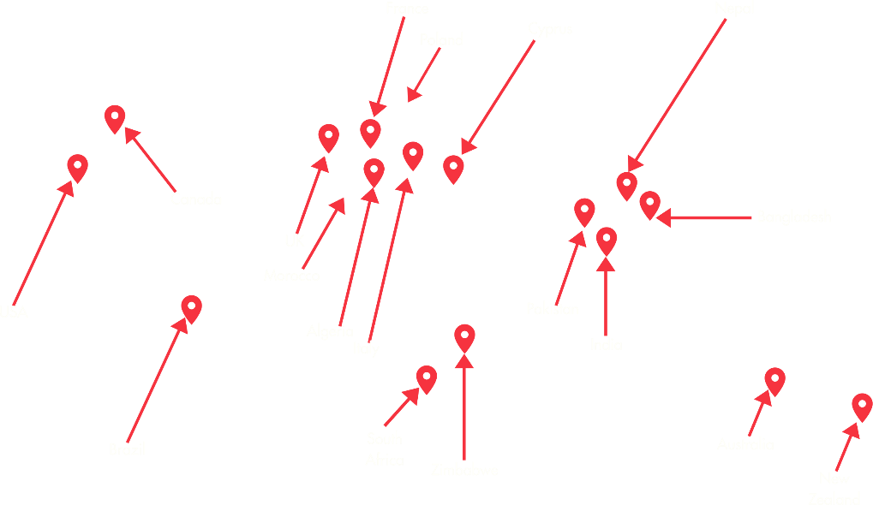
The British, Commonwealth and Allied Forces.
Notes:
The allies didn’t give up. There were four battles at Monte Cassino between 17th January to 18th May 1944. At these battles in Italy, 250,000 troops fought together to free Rome
Britain fought alongside people from all the countries you can see on this map.
Algeria
Australia
Brazil
Canada
Cyprus
France
The British Indian Army (including troops from modern day India, Pakistan and Bangladesh)
Italy
Morocco
Nepal
New Zealand
Poland
South Africa
Southern Rhodesia (now part of Zimbabwe)
USA

Slide 8
“[There were] a lot of stories going about what a terrible place it was so we were already prepared for the worst.”
“People started shouting and screaming and mules are screaming and hell broke loose. You see the path was not just …narrow it was winding on those tight bends, but [the] Germans had positions over the months and months that they were there, pinpointing so close, that all the shells were falling either on one bend or the other, they didn’t even have to look. All night there was movement on that path, there was no other way to get up that mountain, so they just opened fire for ten minutes …. it was like hell!”
“I remember being so hungry and tired and dejected so badly… that I just couldn’t care less if I survived or was dead. That is the first weary part of the war that I experienced… I was completely finished physically.”
Michael Bondel Signaller driver, 1st Polish Carpathian Brigade, 3rd Polish Carpathian Division
Notes:
At 1am on 12th May, Michael advanced forward with the infantry. The signallers had been told to carry arms, but with the all telephone equipment it was too much to carry. They went into battle unarmed and frequently had to stop work and take cover, throwing themselves on the ground under enemy fire.
The casualty rate was extremely high and the wounded officer made the decision to retreat. Soon it would be daylight and the Germans would be able to pick of the remaining soldiers one by one. Michael explained that by the time they got back down and regrouped ‘there was hardly any people left’.
The troops who fought in Italy rather than France were labelled ‘D-Day Dodgers’ because it was thought that they had an easier job to do? Based on Michael’s recount does that seem fair? British soldiers wrote a song about the battle of Monte Cassino and ironically called it ‘D-Day Dodgers’. It ends:
Look around the hillsides, Through the mist and rain, See the scattered crosses, Some that bear no name. Heartbreak and toil and suffering gone, The lads beneath, they slumber on. They are the D-Day Dodgers, Who'll stay in Italy.

Slide 9
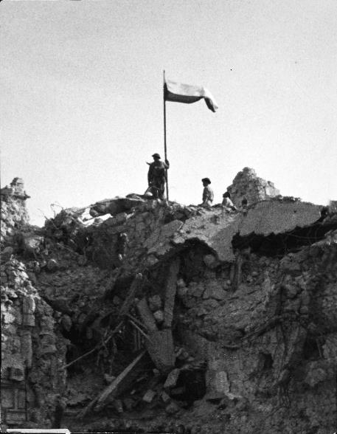
Notes:
On the 18th May 1944, the allied troops finally succeeded in securing Monte Cassino. Over 54,000 people had been lost as a result of the battles.
This photo shows the Polish flag being raised to celebrate the victory and Polish troops resting after the battle.
Image 1: Courtesy of National Army Museum / Image 2: © IWM (NA 15143)

Slide 10
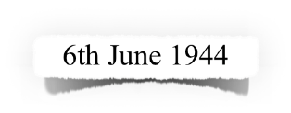

Slide 11
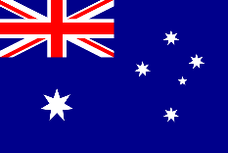
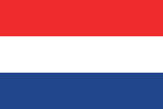
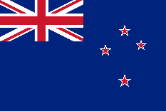
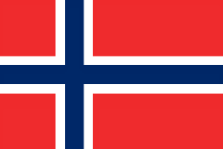
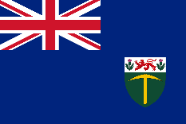
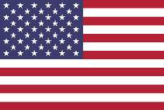
The British, Commonwealth and Allied Forces.
Notes:
D-Day June 6th 1944 was the largest amphibious operation in history. Troops arrived on boats and planes to begin the liberation of Western Europe, supported by intelligence officers and resistance fighters who were already working in France.
Britain and 12 allied nations fought together on D-Day. Their flags are shown here. How many do you recognise?
Australia, Belgium, Canada, Czechoslovakia, France, Greece, the Netherlands, New Zealand, Norway, Poland, Rhodesia and the USA.
Note that Czechoslovakia and Rhodesia are no longer countries - Czechoslovakia became Czech Republic and Slovakia in 1993 and Rhodesia is now called Zimbabwe.
The important fact is that Britain was not alone and all these nations worked hard together to plan and fight an important battle.

Slide 12
More than 1 year to plan
5,000
11,000
23,400
130,000+
Ships
Aeroplanes
Paratroopers
Soldiers fought on the beaches
350,000 members of the French Resistance together with the Special Operation Executive
As well as the nurses, code-breakers, meteorologists, inventors and many, many more who helped make D-Day a success
Notes:
Do students know what happened on D-Day?
It is difficult to imagine the scale of this operation and how it was possible to bring together so many people from so many different countries with one aim: to win back France from Nazi occupation.
To try and ensure that the plans were a secret, the Allies used fake radio commands and double agents to trick the Nazis into thinking the landing would happen somewhere else. Coded messages were sent out via BBC radio to let the Special Operation Executive Agents and French Resistance know that the Allies were coming and their help was needed.

Slide 13
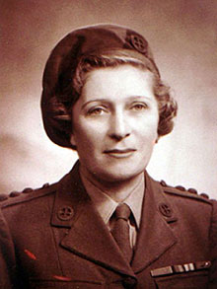
Lise de Boucherville Baissac
As soon as she heard the radio announcements alerting her to the D-Day landings, Lise knew what she had to do.
She cycled for three days, often sleeping in ditches and travelling through areas full of Nazi soldiers, to tell her colleagues in the French Resistance that the Allied troops were on their way.
Her work didn’t finish there. She now needed to help make sure the troops could travel through France to free it from Nazi occupation. She travelled around the country, taking weapons and equipment to other members of the resistance and damaging railways and phone lines so that the Nazis couldn’t use them.
Lise said that life as a spy was "sheer hard work… what was needed was cold-blooded efficiency for long, weary months rather than any bursts of heroism".
Notes:
Source (image and story): https://www.telegraph.co.uk/news/obituaries/military-obituaries/special-forces-obituaries/1458206/Lise-Villameur.html Source (quote): https://www.theguardian.com/news/2004/jun/01/guardianobituaries.france
Lise was born in Mauritius on 11th May 1905
She spoke both English and French
During WWII she worked as a spy for the Special Operations Executive and was one of the first women to parachute into France
She survived the war and was awarded honours including an MBE and the Legion d'Honneur and the Croix de Guerre avec Palme medals

Slide 14
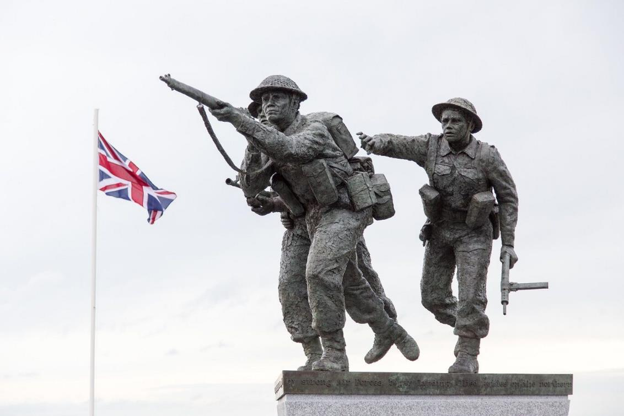
Notes:
Image: Wayne Farrell / Alamy Stock Photo.
In 2019, a statue was unveiled in Normandy, France to commemorate the 75th anniversary of the D-Day landings.
The service was attended by the French President and British Prime Minister and was conducted in English and French. The statue is a symbol of how important it was that the Allied Troops came together on D-Day in 1944 and it will help us to continue to remember together.

Slide 15
Notes:
These battles were fought to prevent a full Japanese invasion of India.
The army was known as the ‘14th Army’ and was compiled of troops from Britain, pre-partition India (made up of India, Pakistan and Bangladesh), Nepal, East and West Africa.
These battles are not as well known as the battles fought in Europe and sometimes this army is referred to as ‘the Forgotten Army’.
Eventually, the 14th Army would become one of the largest armies in the world.

Slide 16
The 14th Army
The 14th army consisted of soldiers from Britain, pre-partition India, Nepal and East and West Africa
The majority of this army was from the British Indian Army
They are sometimes called the ‘Forgotten Army’ as their battles were overshadowed by the fighting in Europe
2.5 million people from pre-partition India volunteered to aid Britain in WWII making it the largest volunteer army in history

Slide 17
“The Japanese had penetrated and outflanked a place we called Lone Tree Hill, and there were no troops between Divisional HQ and the hill. The CO sent for me and said ‘I will take two companies and you stay in the rear’. We got within thirty yards and were grenaded back. We withdrew, took up defensive positions and spent all night there.”
“I knew that early in the morning there would be a final counter-attack. It came and in the hand-to-hand fighting we had many casualties. I felt detached and hatred for the Japanese and a desire to kill them; I became a demon.”
“In battle you reach an extreme state of hatred, but it goes away. You feel sad. How insane war is, but if you don’t kill the enemy, he will kill you.”
Indian Major Dinesh Chandra Misra 5/6th Rajputana Rifles
Notes:
Why does Misra describe war as “insane”?

Slide 18
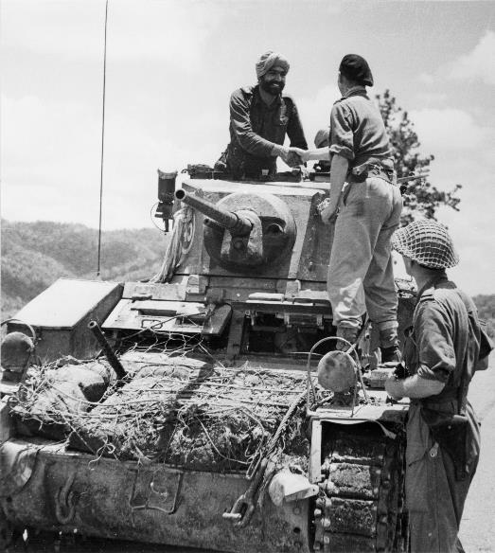
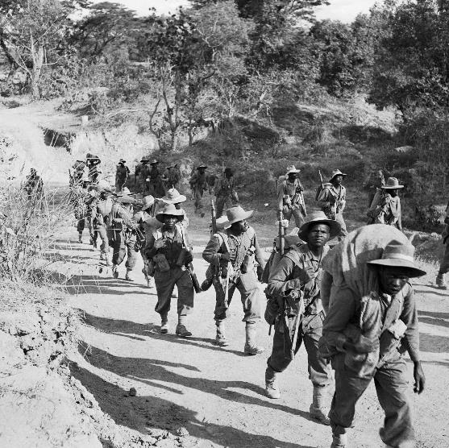
Notes:
Reinforcements came from all over India by air, road and rail to support the soldiers. Eventually they beat the Japanese army.
This meant that the British-Indian army were in a stronger position than the Japanese and they were able to continue fighting to free Burma from Japanese control.
It wouldn’t have been possible without the troops from pre-partition India, Burma, Nepal and countries in east and west Africa.
Image 1: © IWM (HU 88980) / Image 2: © IWM (SE 1884)

Slide 19
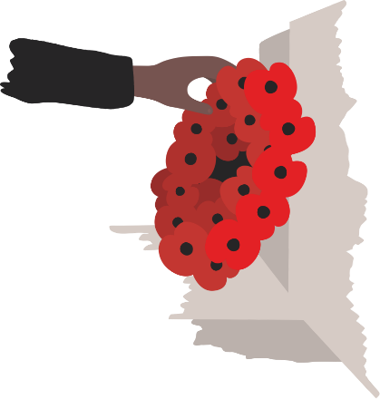
Remember Together reflection
We are grateful for the work of all the people from 46 nations who worked together to win the three battles in 1944.
We remember the bravery, service and sacrifice of the troops who fought at Monte Cassino, on D-Day and at Imphal and Kohima.
We also remember all those who supported the effort: the men and women who made army uniforms in India, tested equipment in the UK, worked as resistance fighters in France, and many more.
By remembering everything we have in common with our allies, we can help to ensure a peaceful world.

Slide 20
“If we are together nothing is impossible.
If we are divided all will fail.”
Winston Churchill
Notes:
Thought for the day

