Slide 1
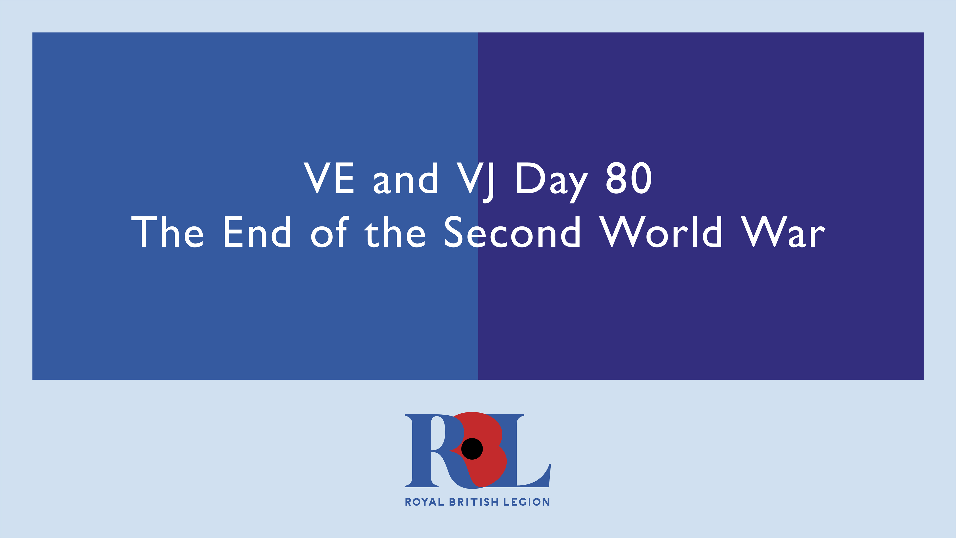
Notes:
Presenter Guidance Notes
Overall Aim: To commemorate the 80th anniversary of the end of World War II, remember those who served and sacrificed, and reflect on the war's lasting impact.
Target Audience: General audience
This presentation is a tribute to those who served and sacrificed during The Second World War. Approach it with respect and sensitivity, ensuring that their stories are honoured and remembered.
Welcome the audience and thank them for attending.
Briefly introduce the topic and its significance.
Mention the 80th anniversary of the end of World War II.

Slide 2
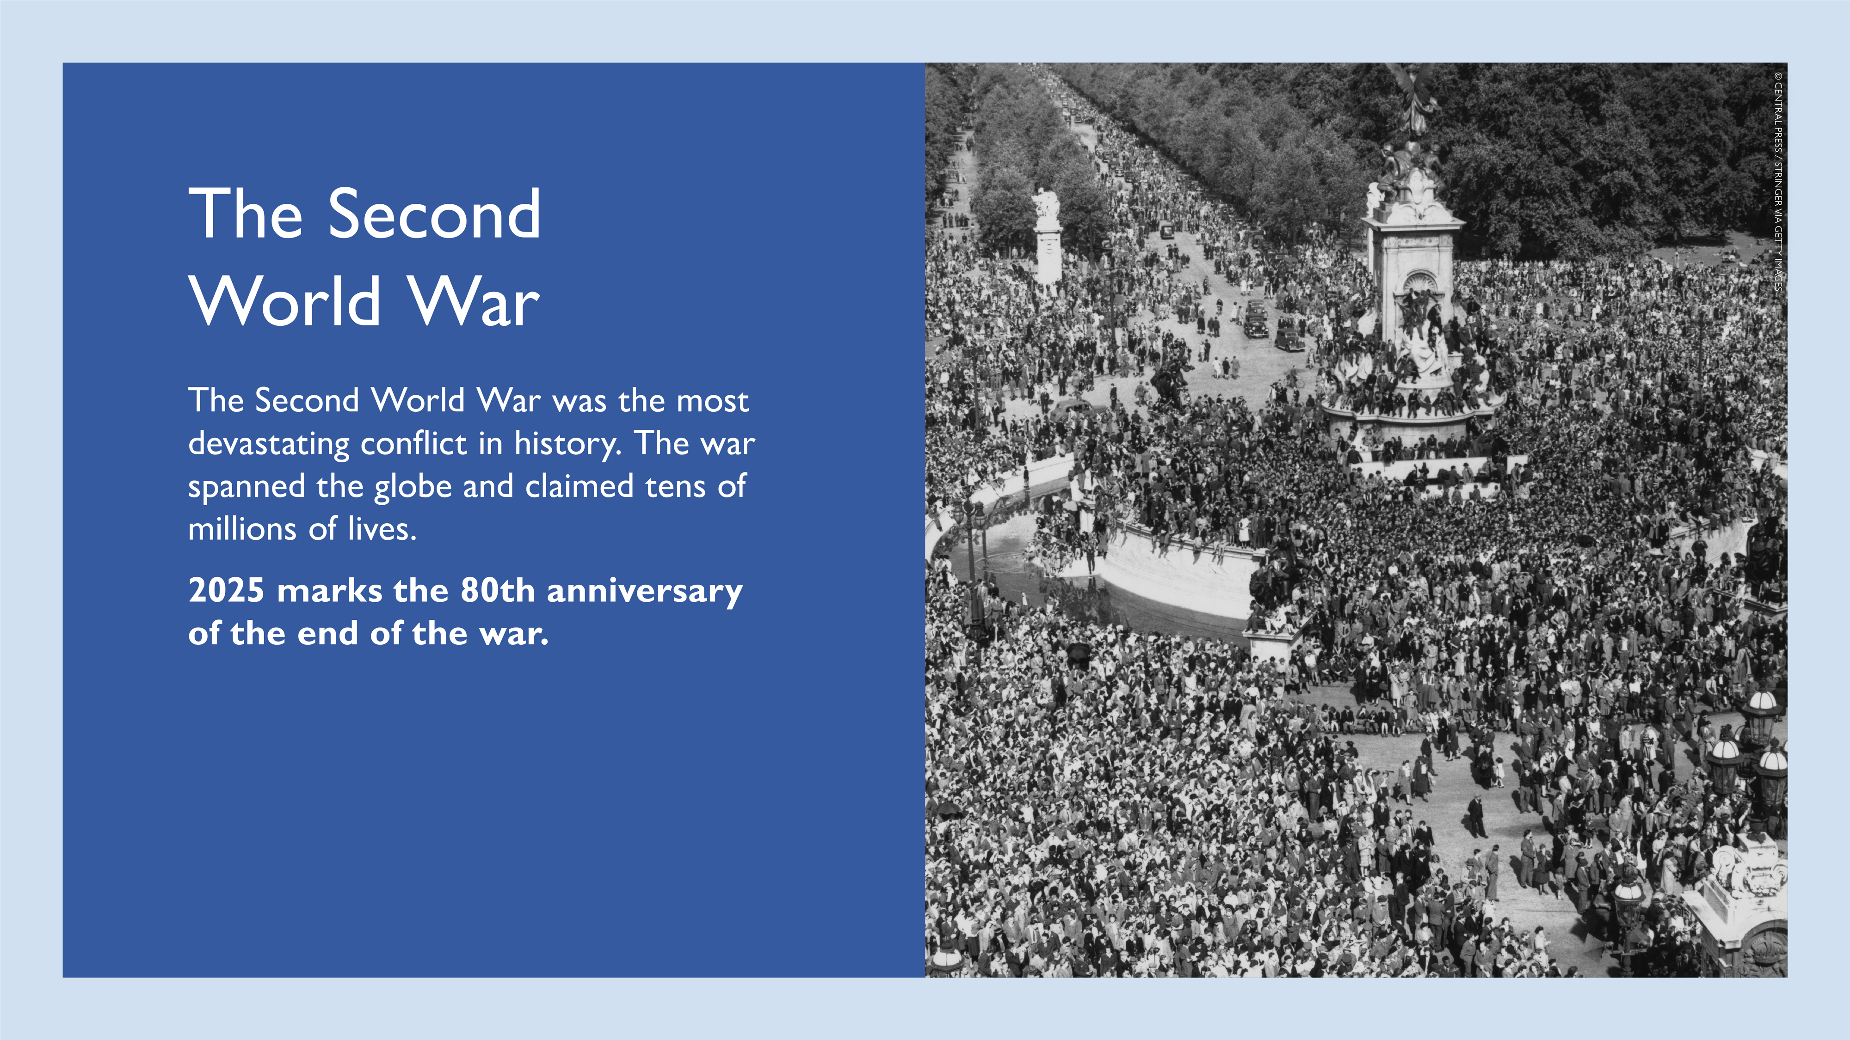
Notes:
Reflect on the war's devastating scale and global impact.
Mention the 80th anniversary and the importance of remembrance.
Image: VJ Day Celebrations, Buckingham Palace.

Slide 3
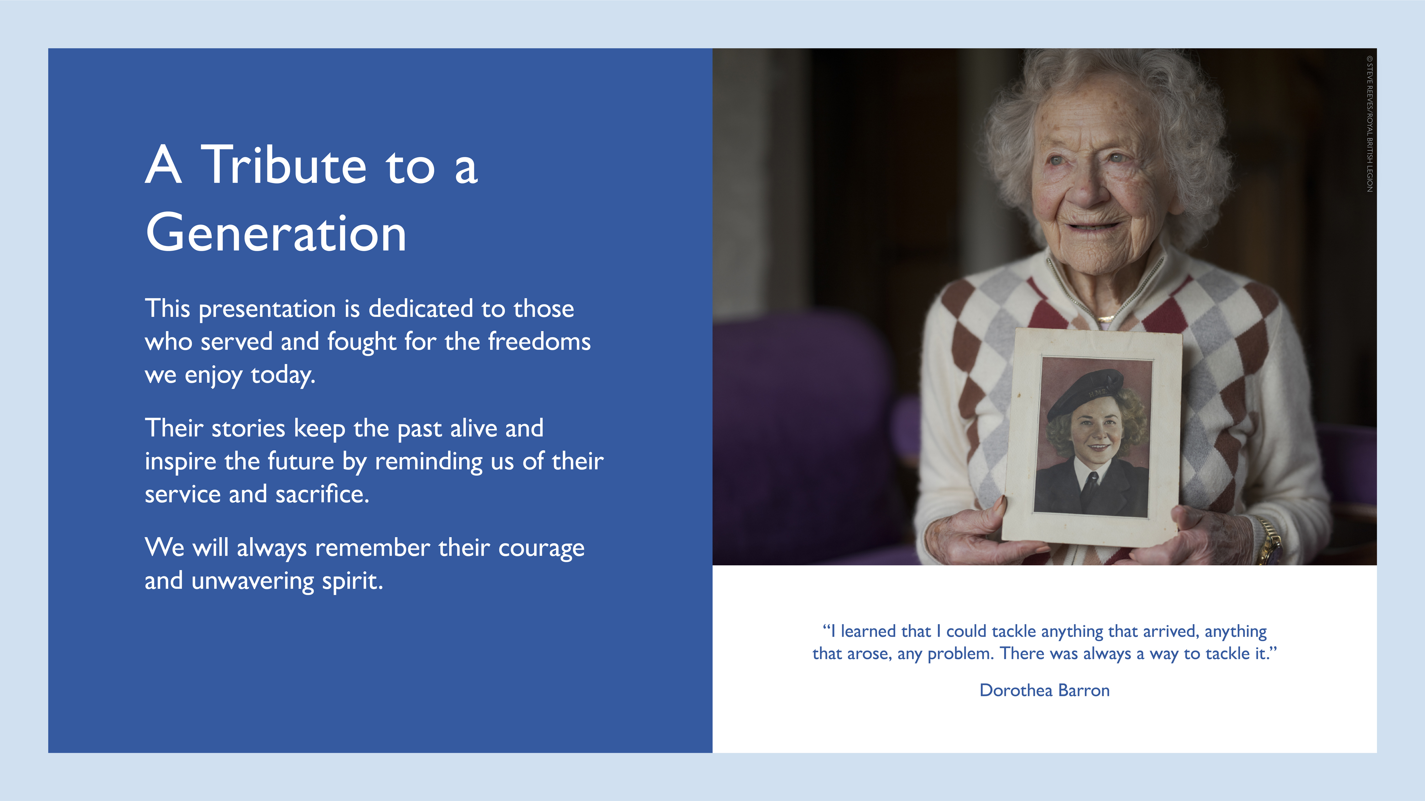
Notes:
Image of Dorothea Barron, WRNS visual signaller

Slide 4
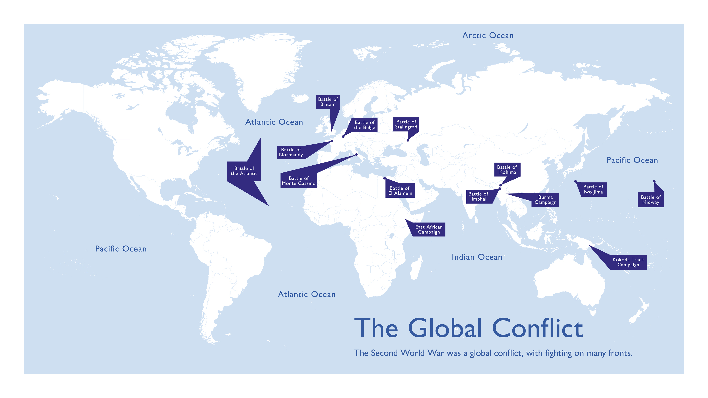
Notes:
Reflect on the war's devastating scale and global impact.

Slide 5
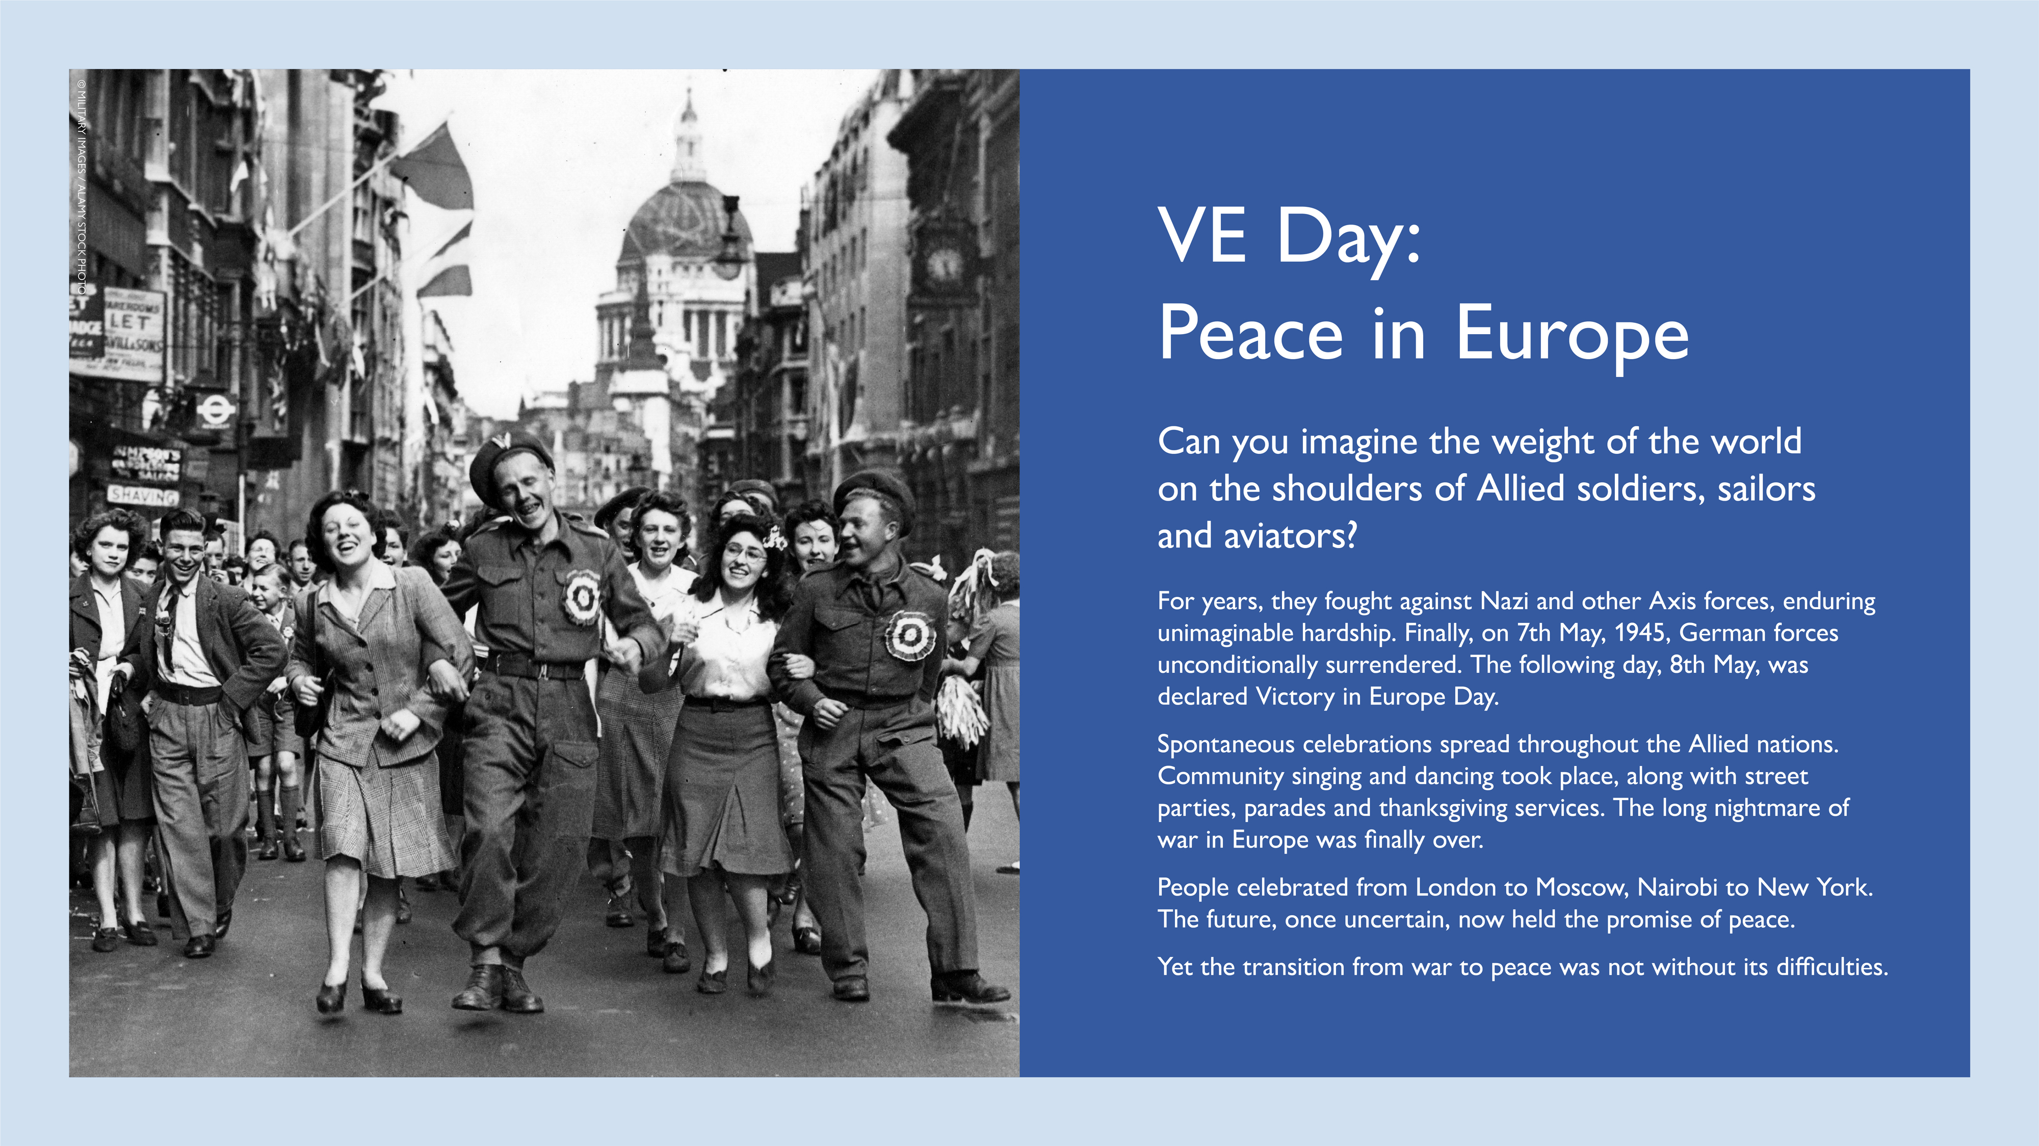
Notes:
Explain the significance of VE Day and Germany's surrender.
Describe the spontaneous celebrations and the atmosphere of relief.
Image: VE Day in London 1945. Servicemen join revellers as they party for VE Day in London

Slide 6
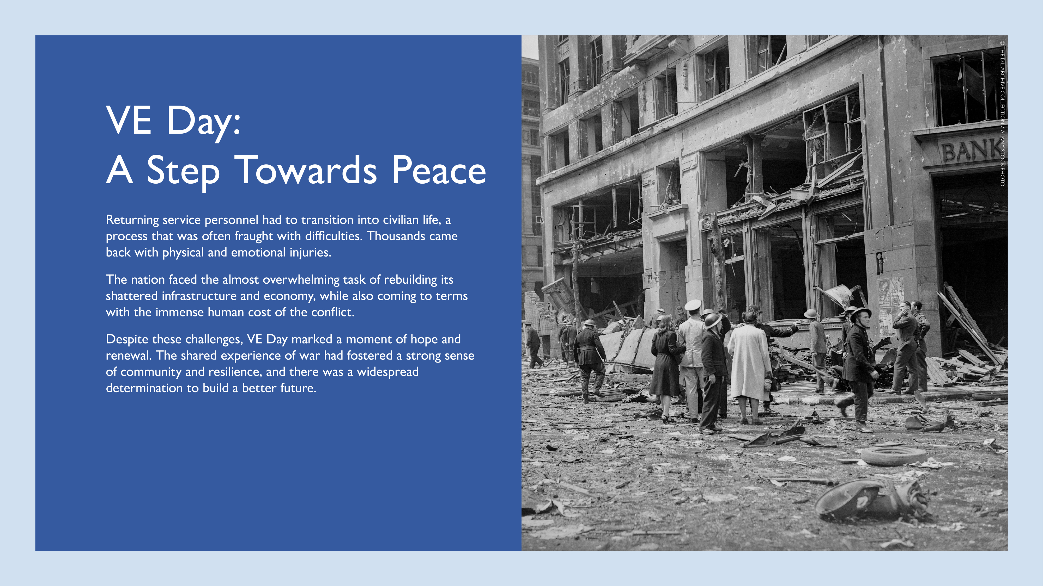
Notes:
Mention the challenges of transitioning from war to peace.
Image: LONDON - JUNE 30: On 30 June 1944, Aldwych WC2 suffered one of the deadliest V1 flying bomb attacks of the war. A fortnight after the first V1 strikes on London, the menacing drone of yet another ‘Doodlebug’ was heard over the capital. Aldwych was crowded with workers returning from their lunch hour or queuing at the local Post Office. At 2.07pm the V1 glided silently in over the Thames, diving down to explode on the road between the Air Ministry and the north-east wing of Bush House, home to the BBC External Services. Although the steel-framed Air Ministry absorbed much of the explosion, leaving the buildings astride the roadway largely intact, the blast wave scythed down the street. 46 people were killed and at least 200 others suffered serious injuries. Many of these were inflicted by flying glass fragments from hundreds of shattered windows. Five members of the Women's Auxiliary Air Force (WAAF) died on the upper floors of the Air Ministry. Nearby, Australia House suffered serious damage, and the foyer of the Aldwych Theatre was destroyed.

Slide 7
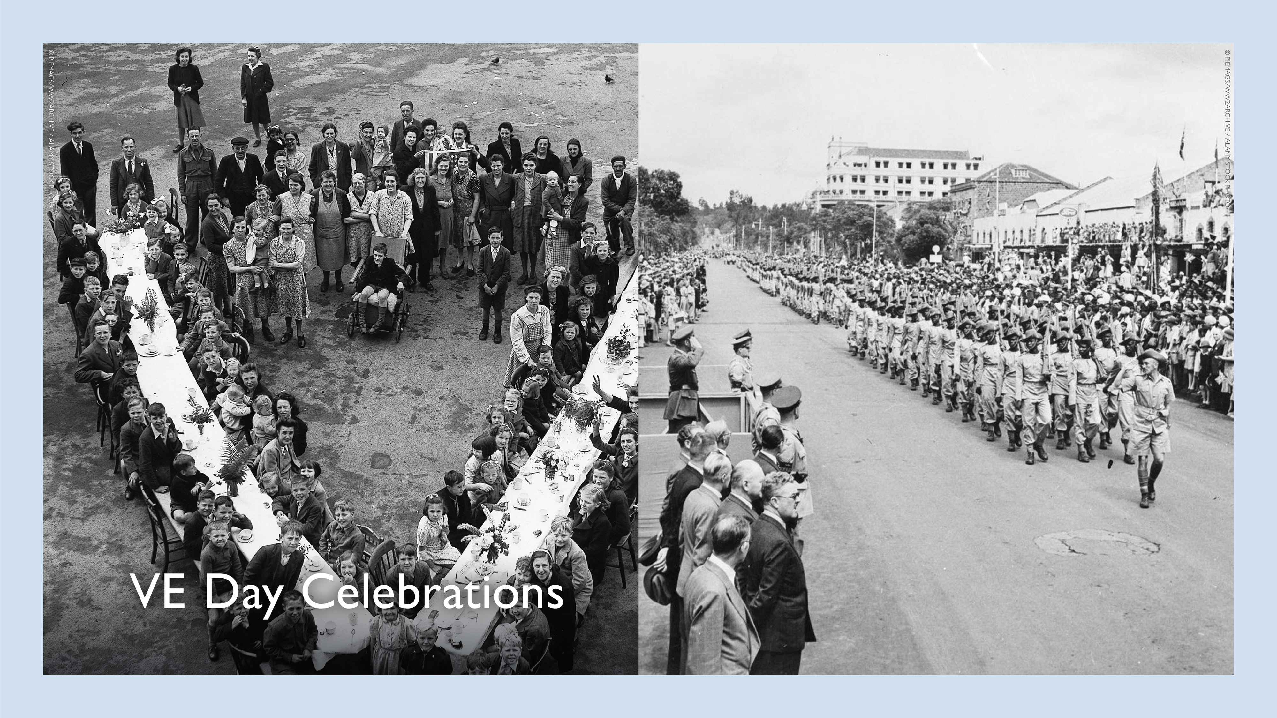
Notes:
Briefly describe the various celebrations that took place around the world.
If possible, share additional personal anecdotes or stories related to VE Day celebrations.
Left Image: Children's party celebrating VE Day in South London.
Right Image: VE Day celebrations at Nairobi, Kenya. The band of the King's African Rifles lead a parade through the crowded streets of the Kenyan capital. The regiment was greatly expanded during World War Two and at one stage consisted of 44 battalions and several independent garrison companies.

Slide 8
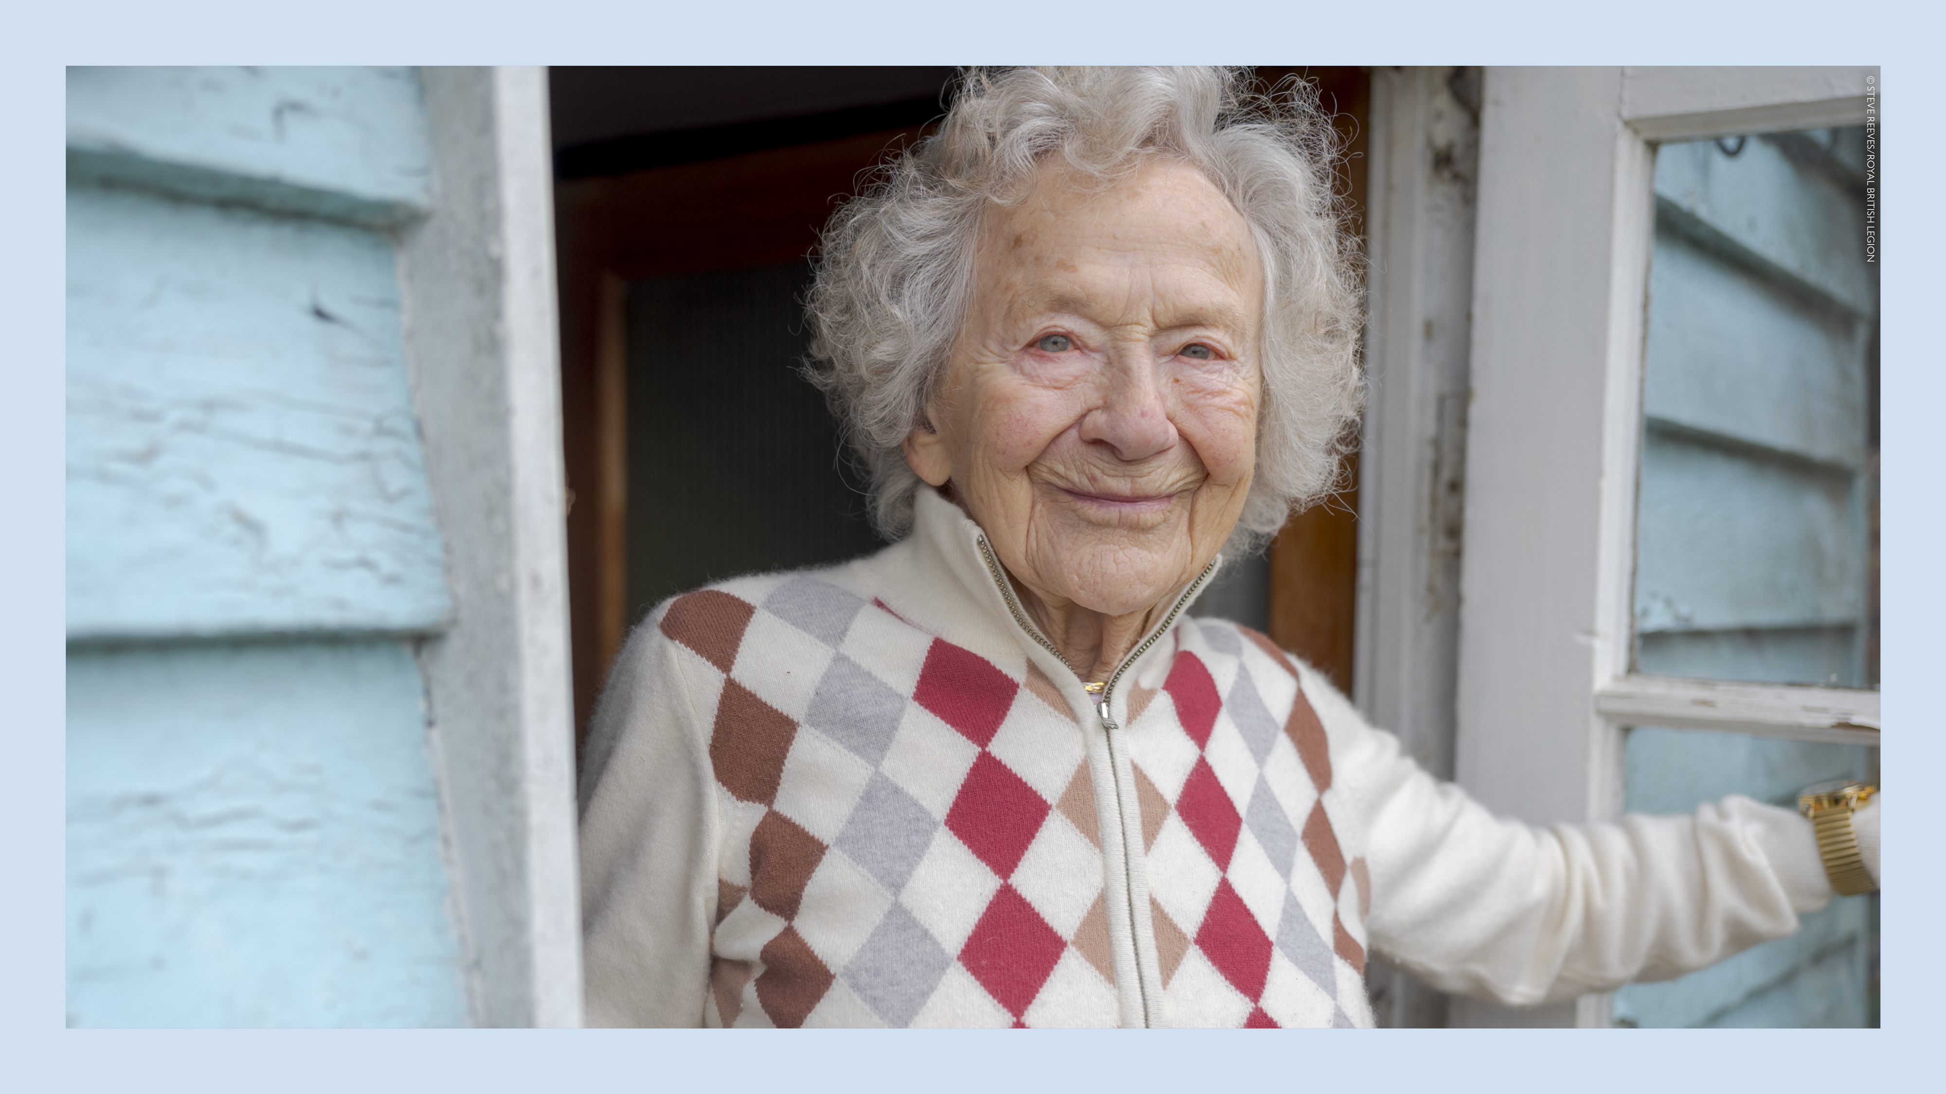
Notes:
Dorothea Barron

Slide 9
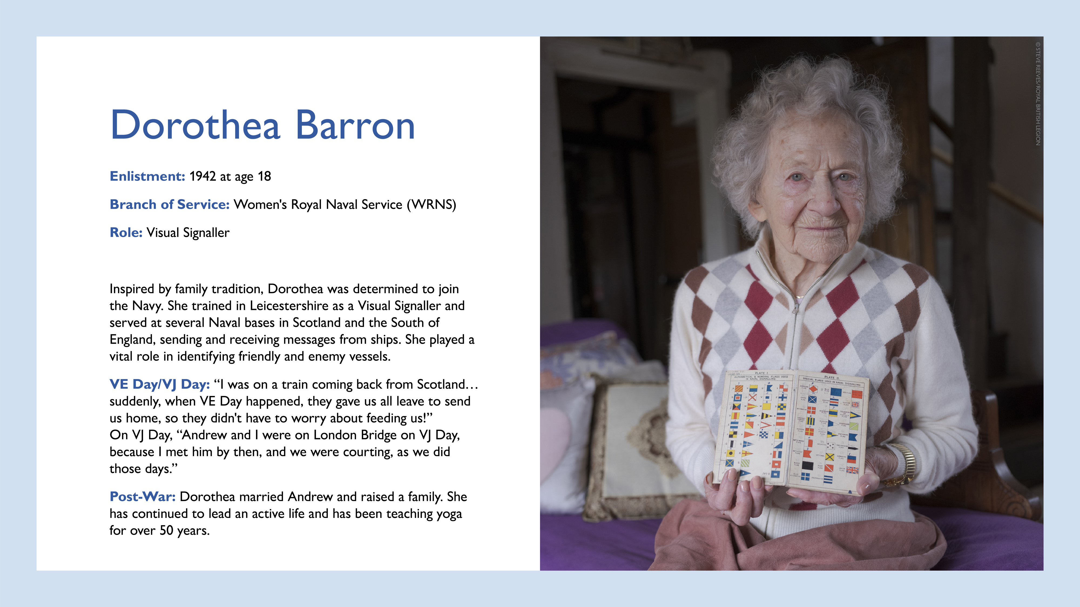
Notes:
Share details about Dorothea Barron's inspiration for joining the Navy and her role as a Visual Signaller.
Mention her training and postings in Scotland and the Isle of Wight.
Highlight her vital role in identifying vessels.
Recount her memories of VE Day and VJ Day.
Briefly describe her post-war life and family.

Slide 10
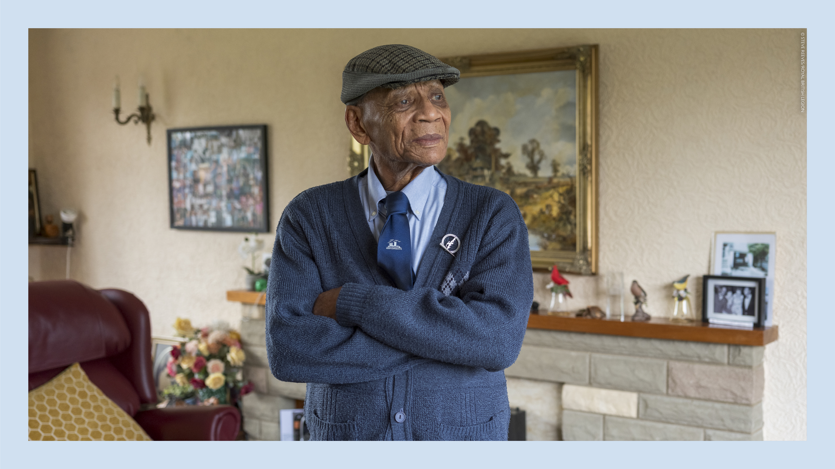
Notes:
Ralph Ottey

Slide 11
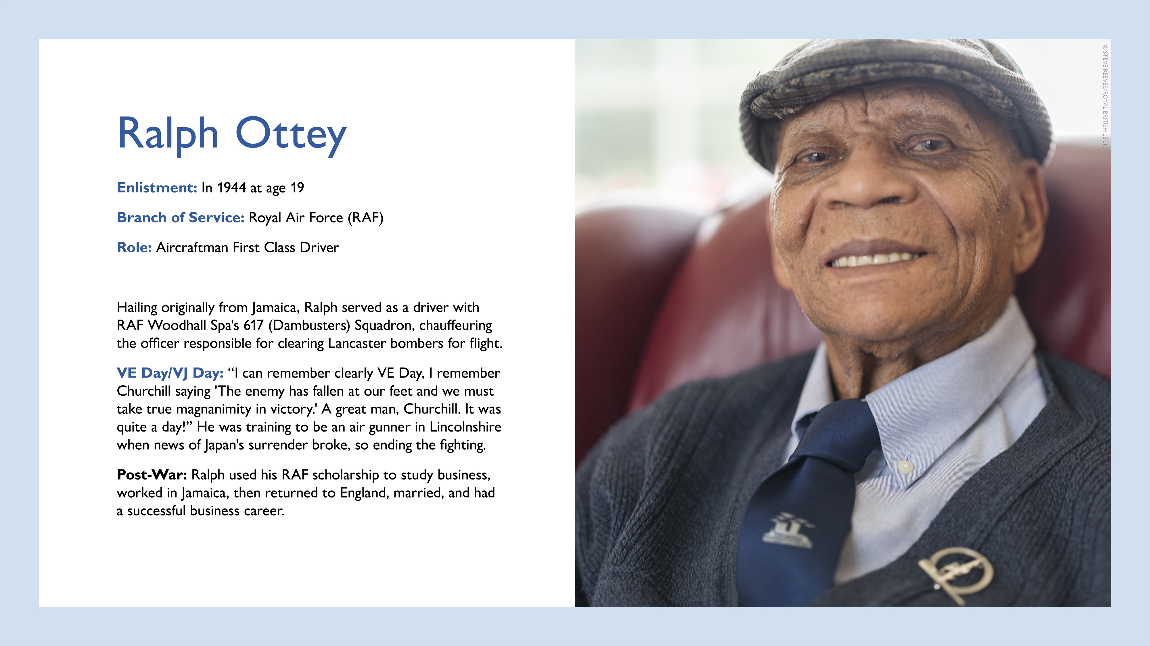
Notes:
Share details about Ralph Ottey's life, enlistment, and role in the RAF.
Highlight his service with the 617 (Dambusters) Squadron.
Recount his memories of VE Day and Churchill's speech.
Mention his training as an air gunner and the news of Japan's surrender.
Briefly describe his successful post-war career.

Slide 12
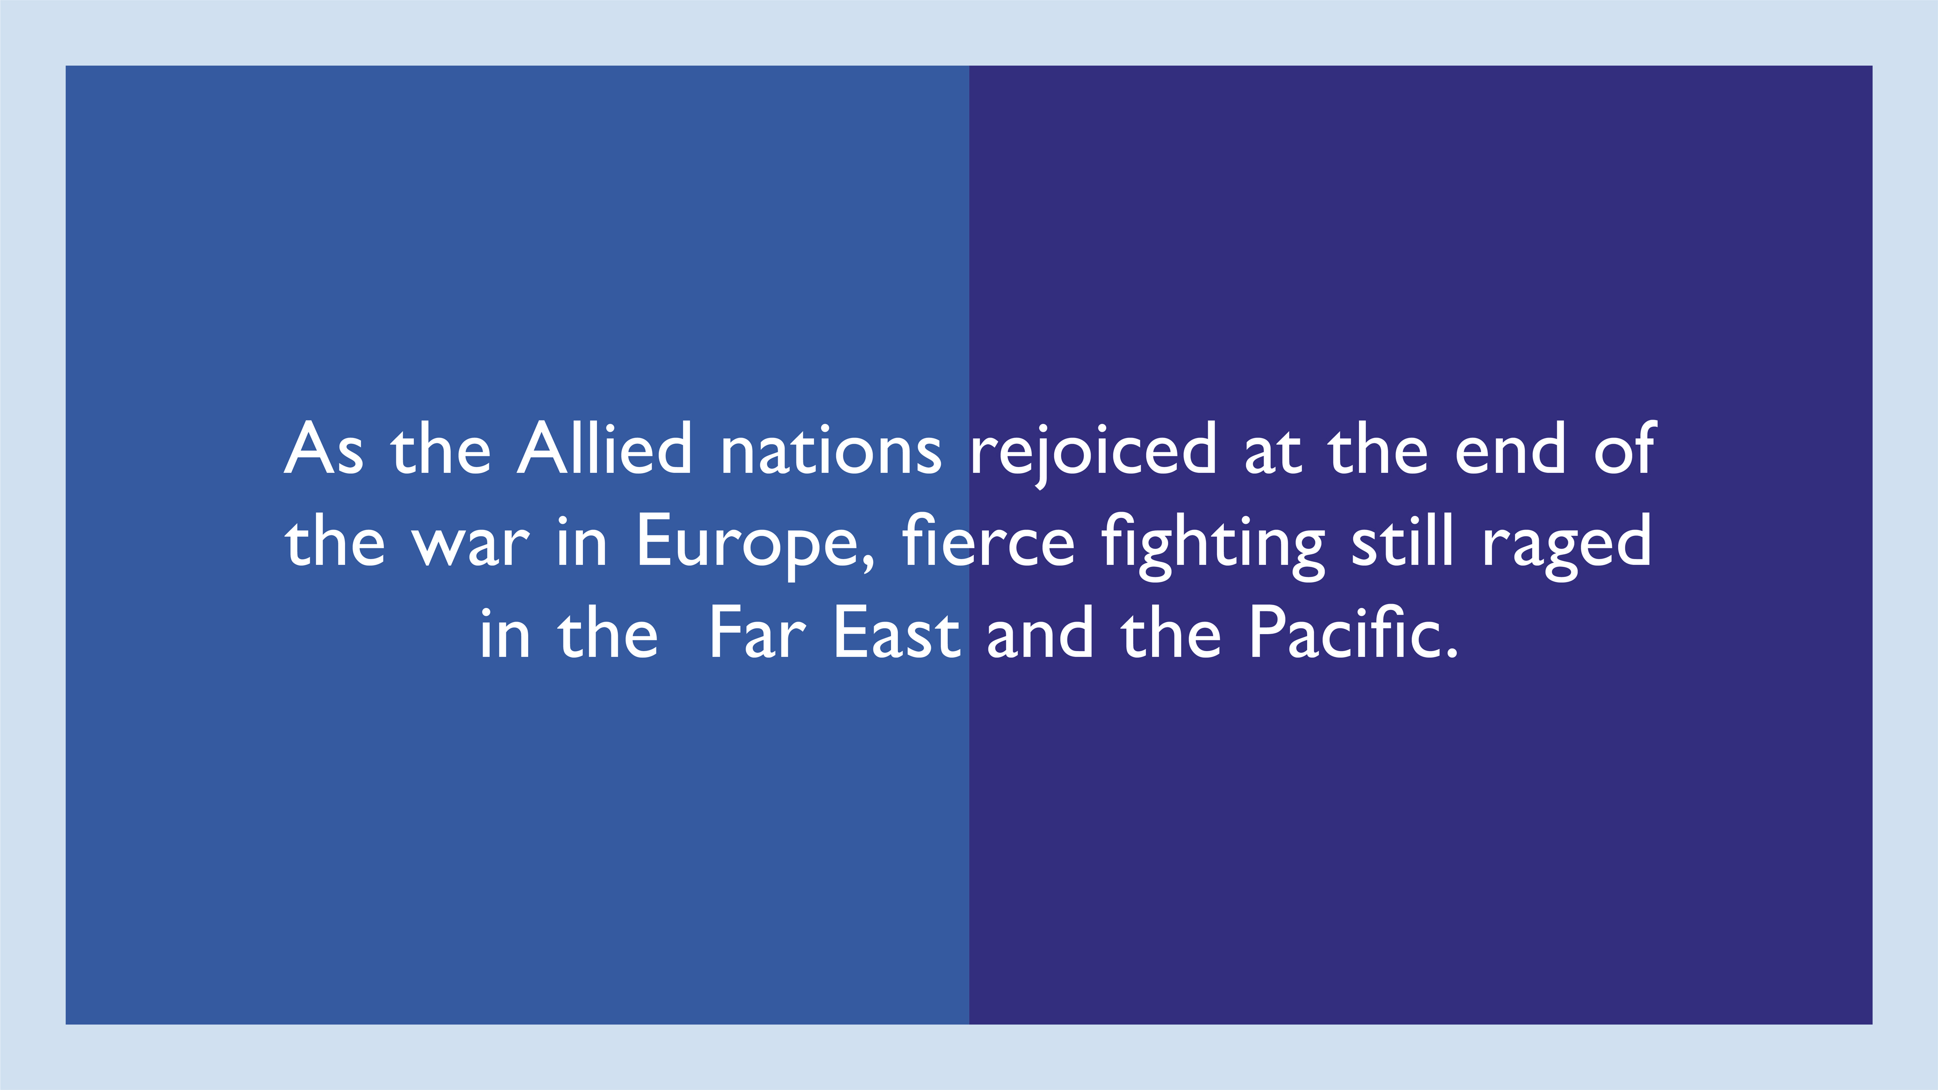

Slide 13
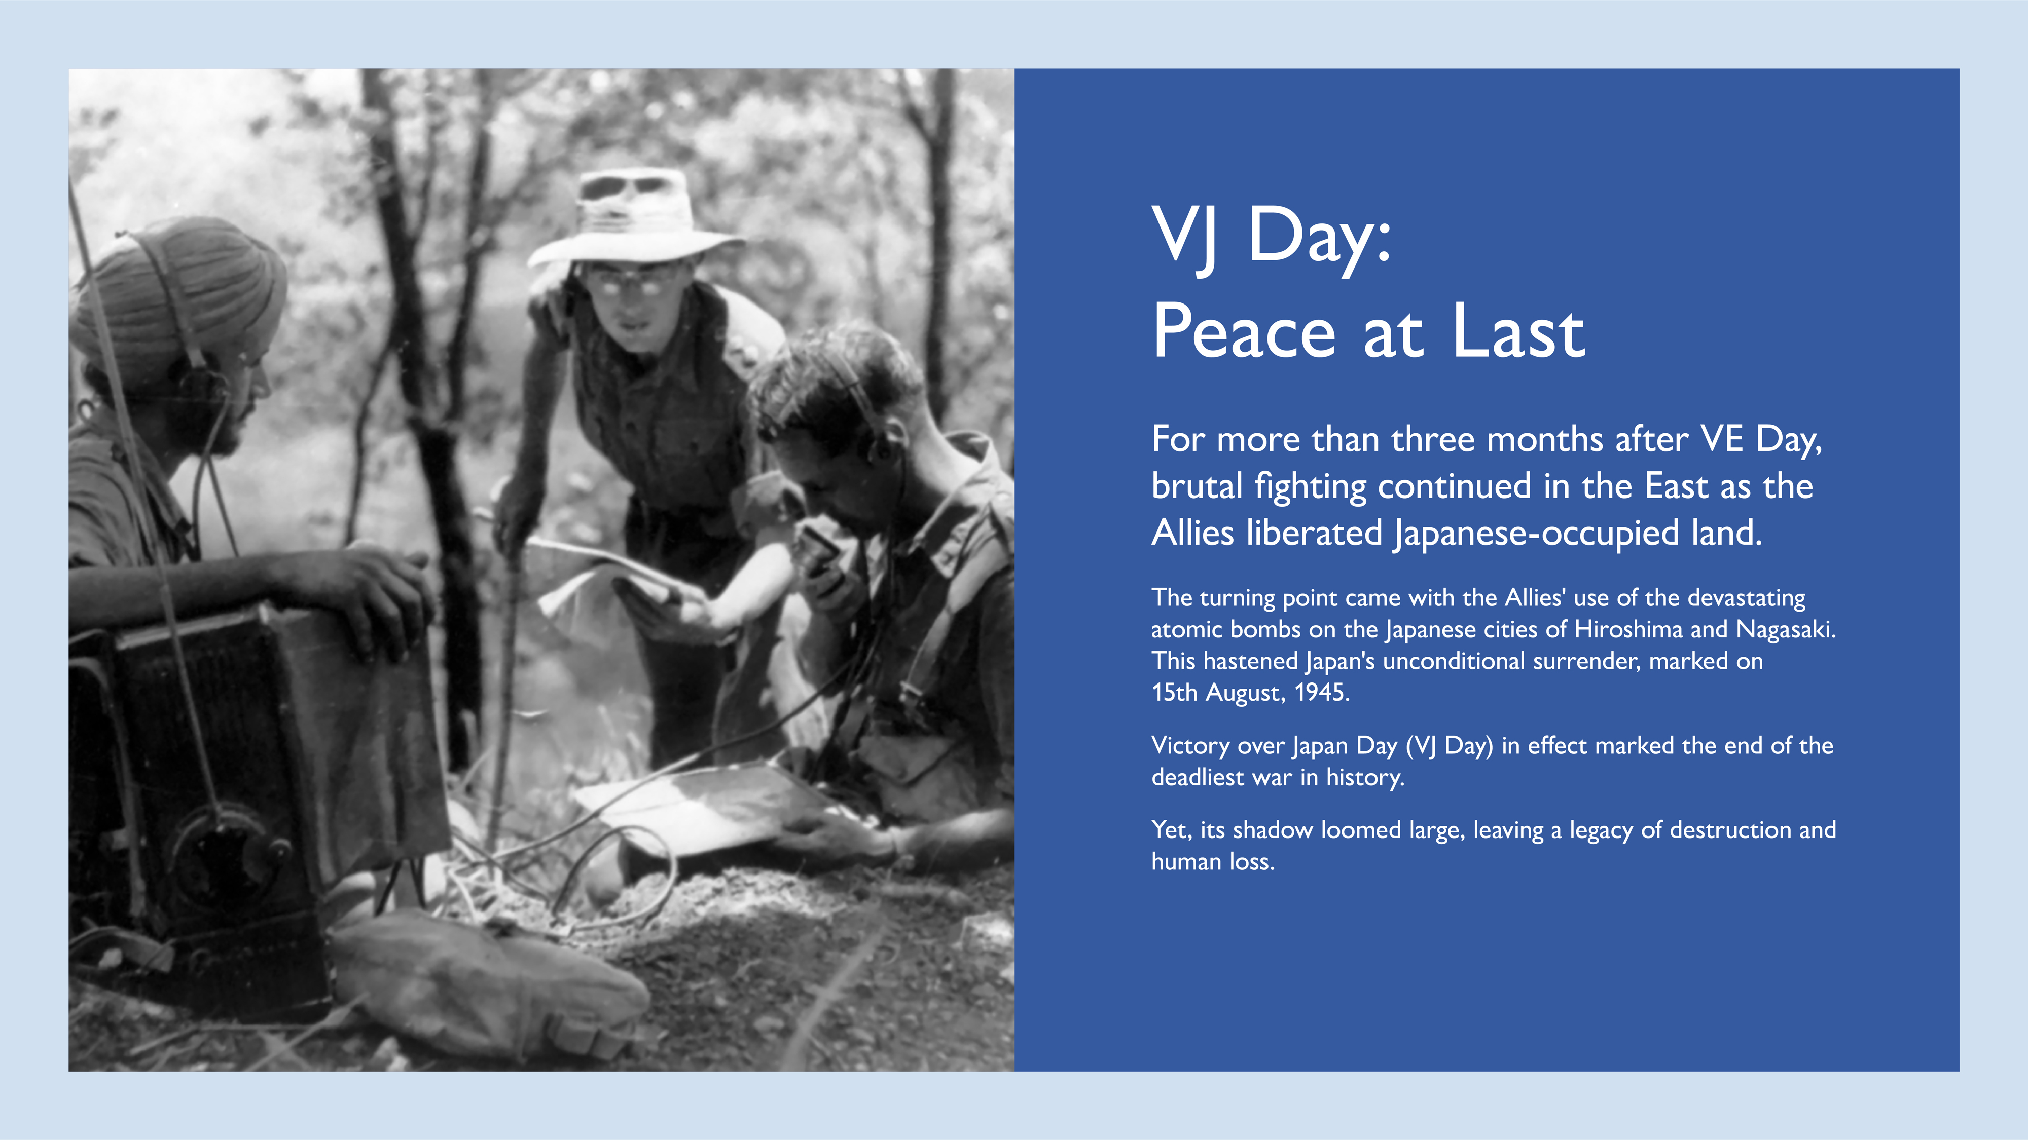
Notes:
Explain the continued fighting in the Far East after VE Day.
Discuss the impact of the atomic bombs on Hiroshima and Nagasaki.
Mention Japan's surrender and the significance of VJ Day.
Reflect on the war's devastating legacy.
Image: On Imphal front, Sikh signaller operates walkie-talkie for British officers, listening to patrols reporting Japanese positions

Slide 14
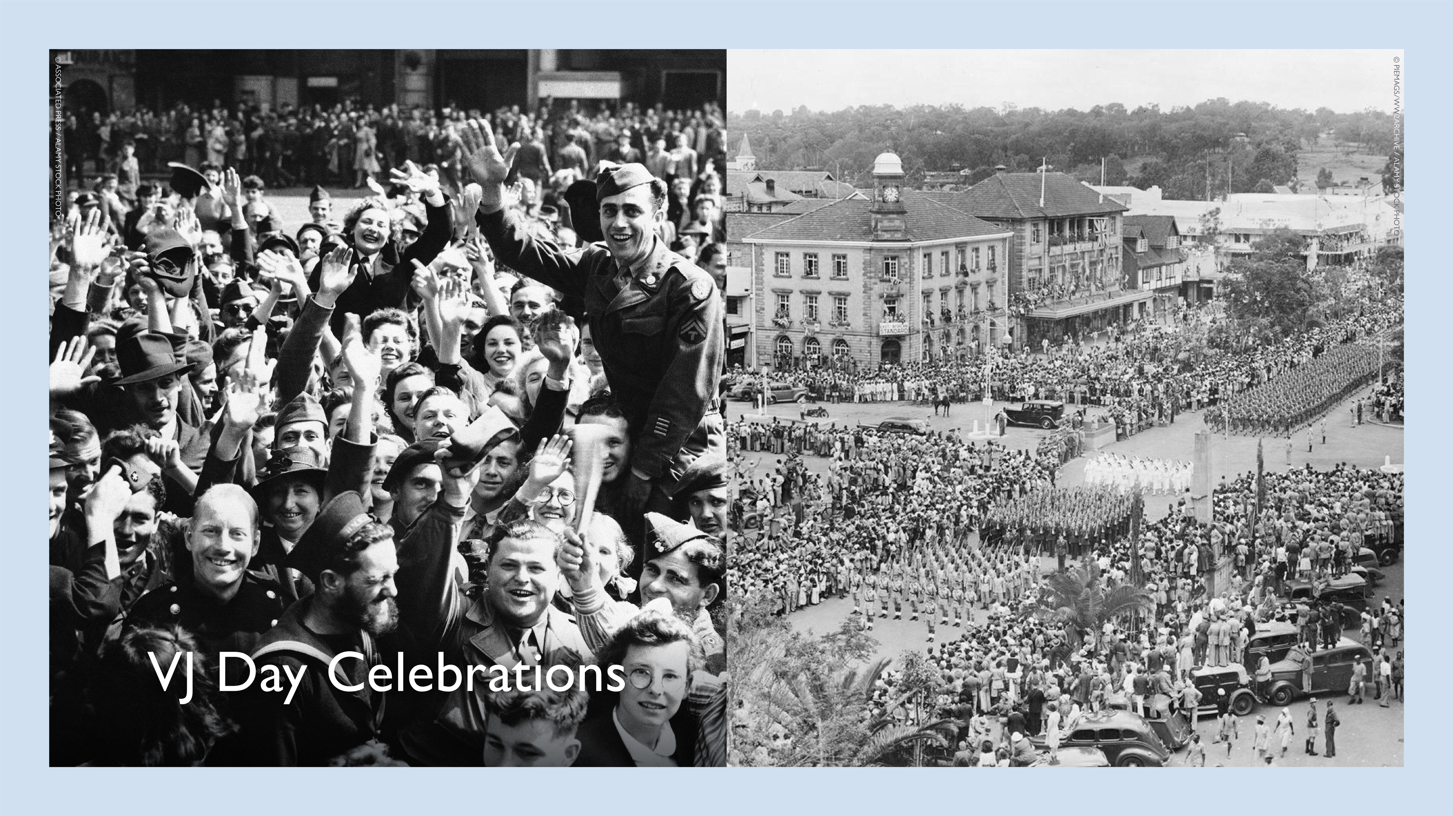
Notes:
Describe the global celebrations marking the end of the war.
Highlight the joy and relief felt by people around the world.
If possible, share personal anecdotes or stories related to VJ Day celebrations.
Left Image : The jubilant crowds at Piccadilly Circus in London on hearing of the Japanese surrender on VJ Day in England, Aug. 10, 1945.
Right Image : A parade of 5,000 troops was part of Nairobi's VJ Day Celebrations. Picture shows: The parade seen from the roof of a tall building in Delamere Avenue. 15 August 1945

Slide 15
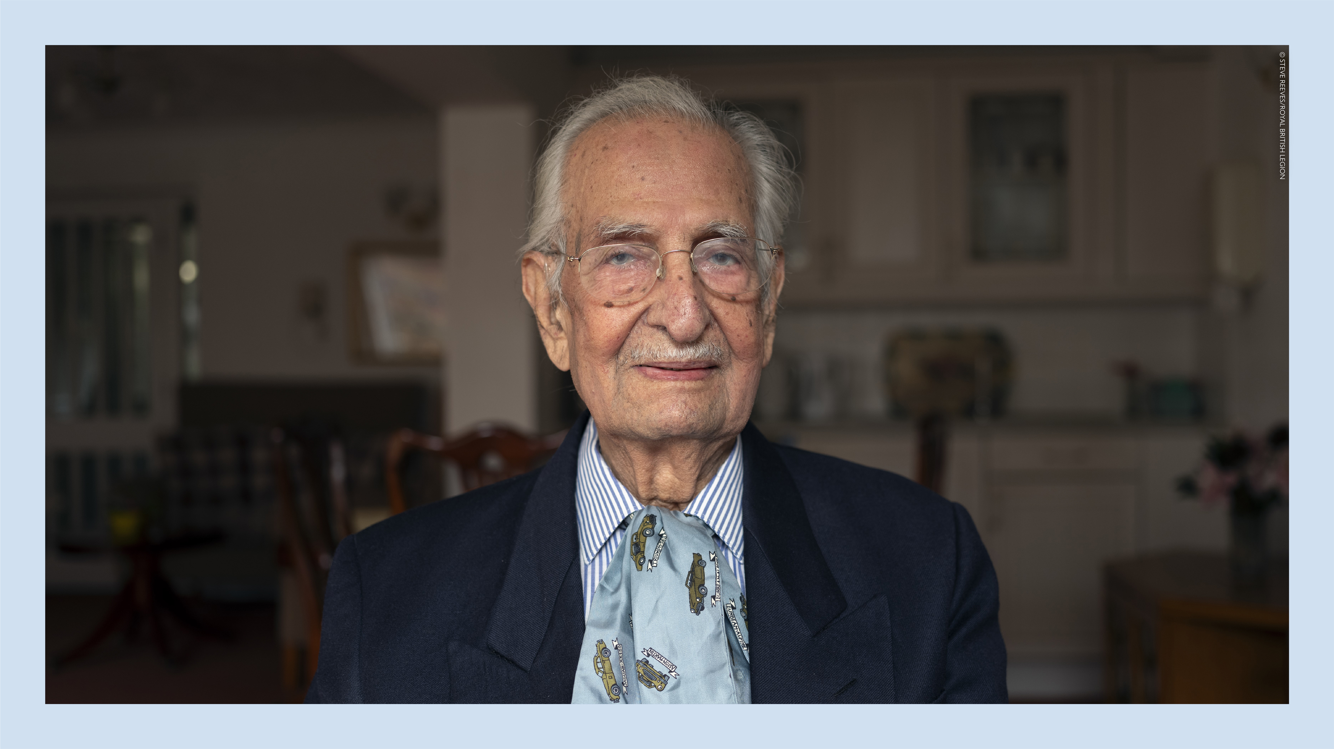
Notes:
Yavar Abbas

Slide 16
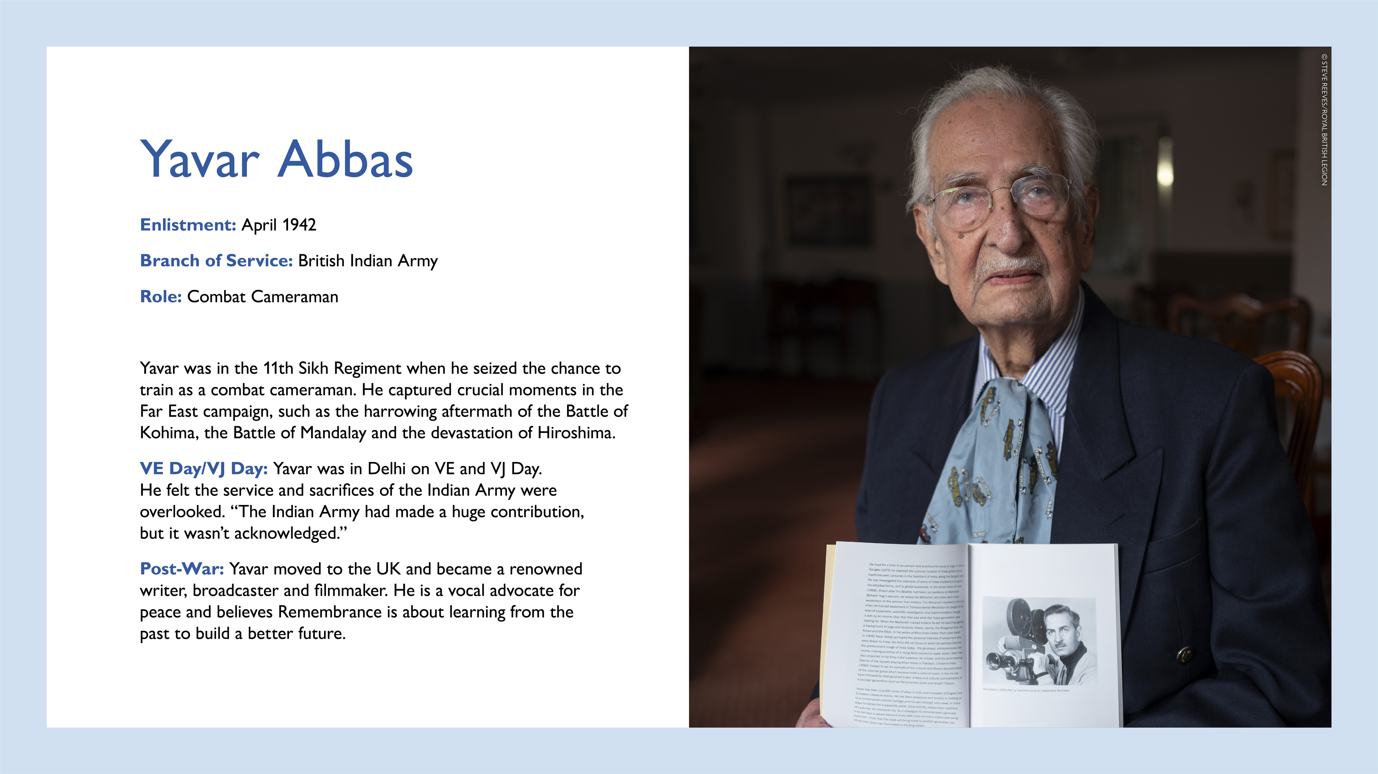
Notes:
Share details about Yavar Abbas' enlistment, role as a combat cameraman, and the 11th Sikh Regiment.
Mention his documentation of key battles in the Far East and Hiroshima.
Discuss his perspective on the Indian Army's overlooked contributions.
Briefly describe his post-war career as a writer, broadcaster, and filmmaker.
Emphasise his advocacy for peace and remembrance.

Slide 17


Slide 18
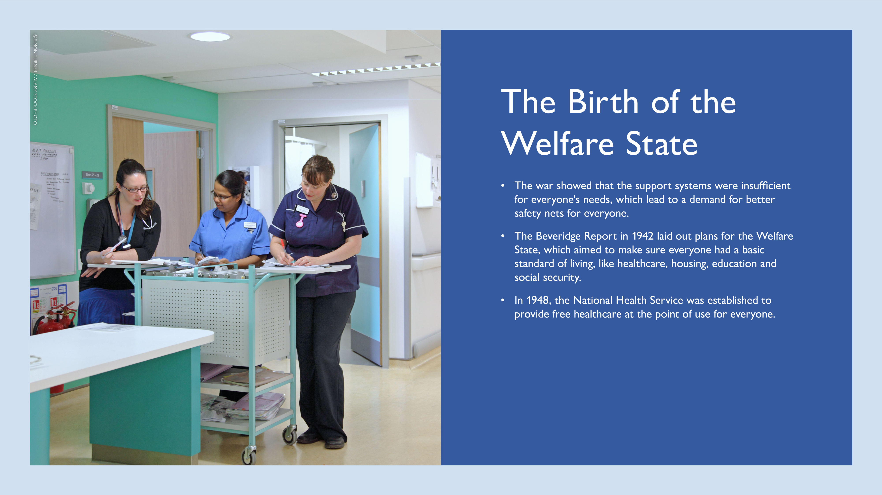
Notes:
Discuss the goals of providing healthcare, housing, education, and social security.
Image: Modern UK hospital ward - nurses station. Two nurses discuss patient documents with a female doctor. Male doctor walking past.

Slide 19

Notes:
Discuss the psychological impact of the war on service personnel and civilians.
Explain the recognition of "Battle Fatigue" (PTSD) and new treatments.
Emphasise the reduction in stigma surrounding mental illness.
Briefly describe the memorial and its location at the National Memorial Arboretum.
Explain its purpose as a place for remembering those who battled PTSD and other mental illnesses.
Image: The Sapper Support memorial at the National Memorial Arboretum – a place for families and friends to remember those who have left us after battling with PTSD and other associated mental illnesses.

Slide 20
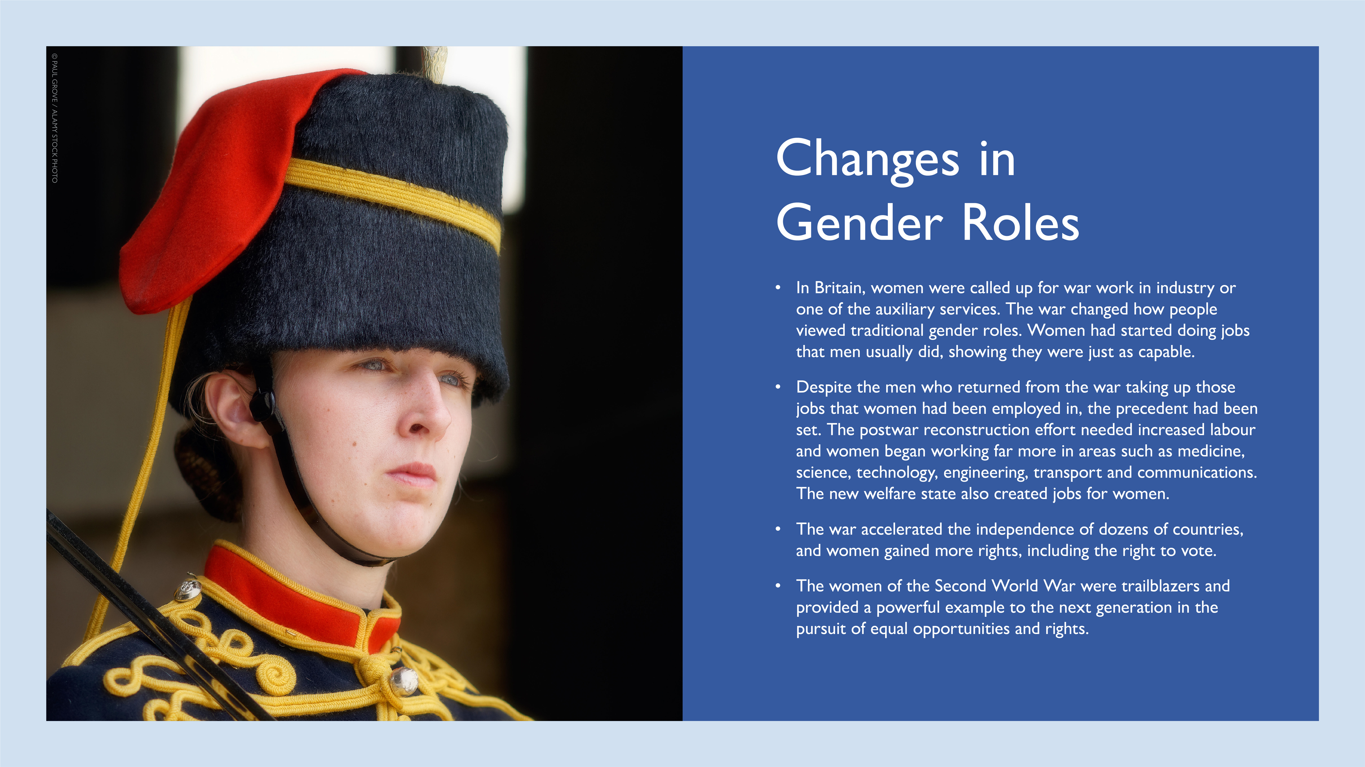
Notes:
Discuss how women's roles changed during the war.
Highlight their capabilities and contributions in various fields.
Mention the impact on women's rights and societal roles.
Image: Female Soldier, King's Troop, Royal Horse Artillery. The King's Troop, Royal Horse Artillery is a ceremonial unit of the British Army, quartered at Woolwich. It is a mounted unit and all of its soldiers are trained to care for and drive teams of six horses pulling each of six First World War-era 13-pounder field guns used today to fire salutes on state occasions. Its duties include the firing of royal salutes on royal anniversaries and state occasions, and providing a gun carriage and team of black horses for state and military funerals. The unit is most often seen providing gun salutes on state occasions in Hyde Park, and Green Park.

Slide 21
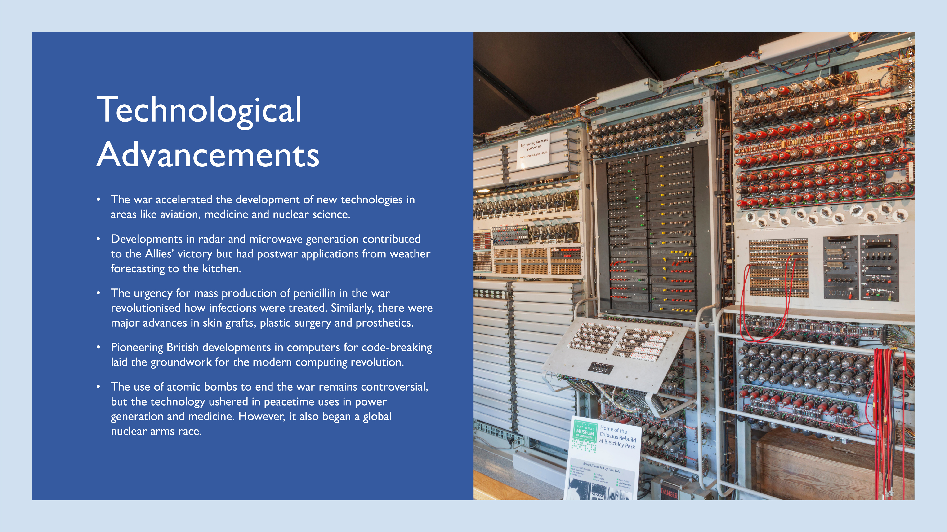
Notes:
Discuss the war's role in accelerating technological development.
Provide examples of advancements in aviation, medicine, and nuclear science.
Mention the development of radar, penicillin, skin grafts, prosthetics, and computers.
Briefly discuss the controversial use of atomic bombs and their peacetime applications.
Image: England, Buckinghamshire, Bletchley, Bletchley Park, Colossus Computer

Slide 22
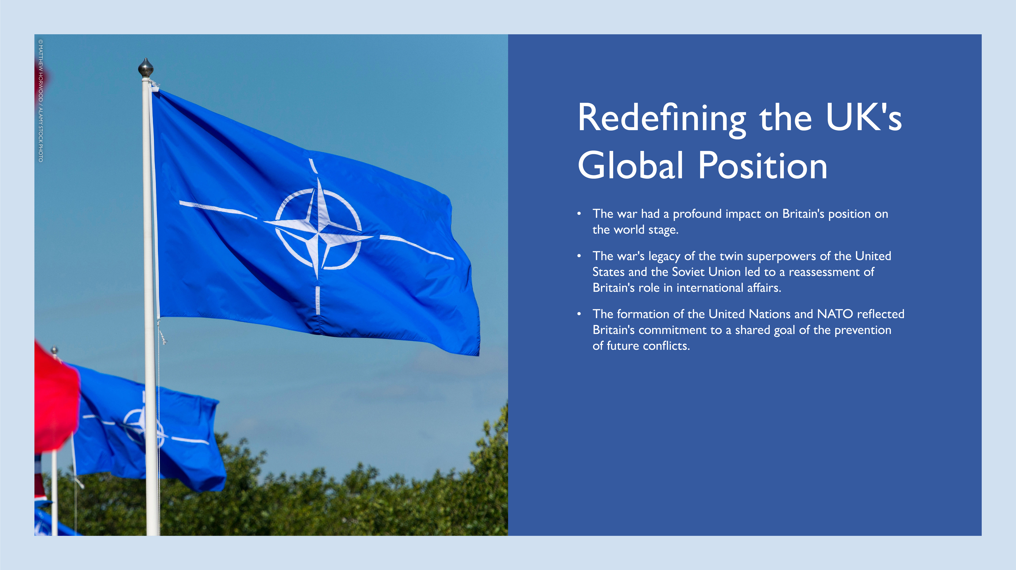
Notes:
Explain how the war impacted Britain's global standing.
Mention the emergence of the US and the Soviet Union as superpowers.
Discuss the formation of the United Nations and NATO.
Highlight Britain's commitment to preventing future conflicts.
Image: A NATO flag flies at Cardiff Castle during the NATO summit which was held in Newport.

Slide 23
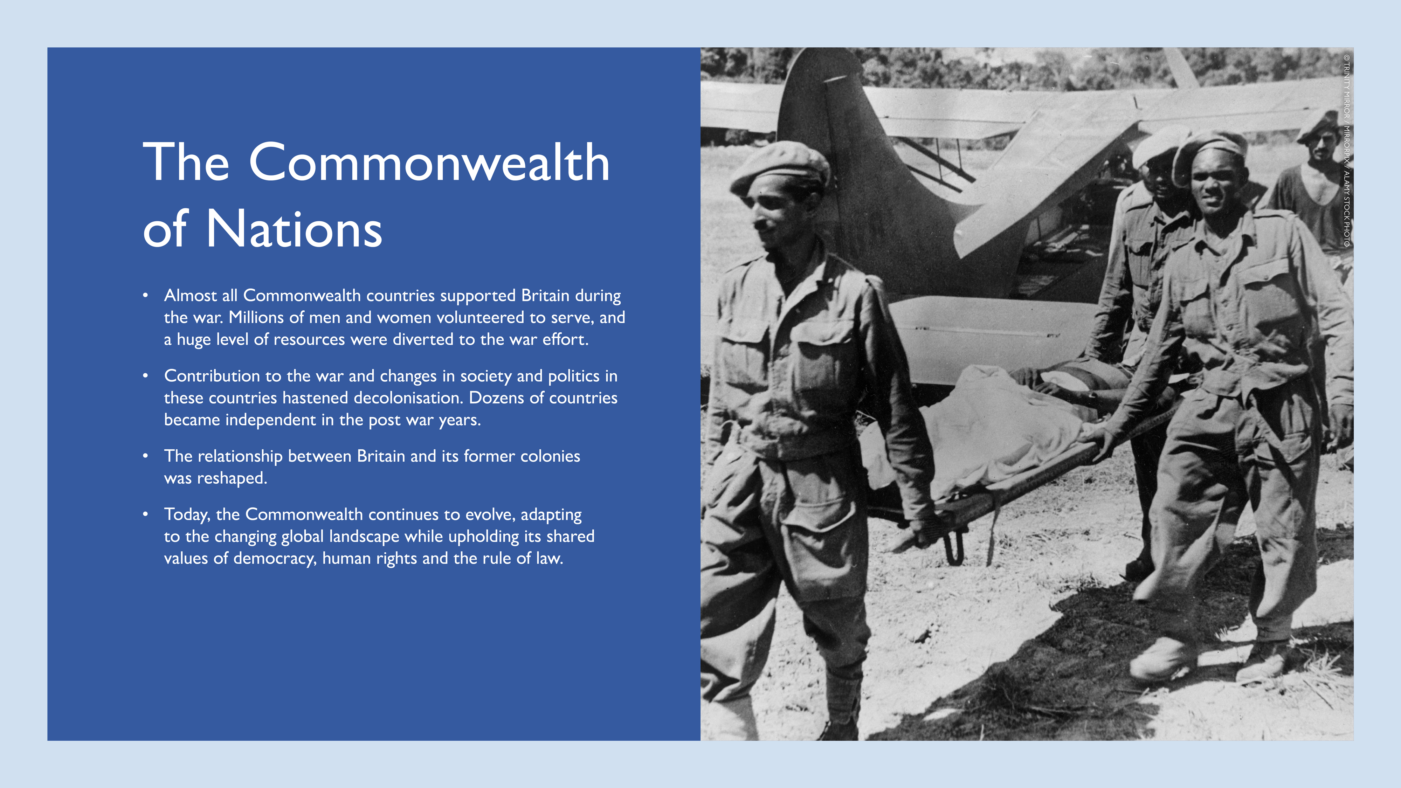
Notes:
Discuss the contributions of Commonwealth countries to the war effort.
Explain how the war influenced decolonisation and independence movements.
Mention the reshaped relationship between Britain and its former colonies.
Highlight the Commonwealth's continued evolution and shared values.
Image: A wounded West African soldier is carried on a stretcher by soldiers after fighting in Burma during the Second World War.

Slide 24
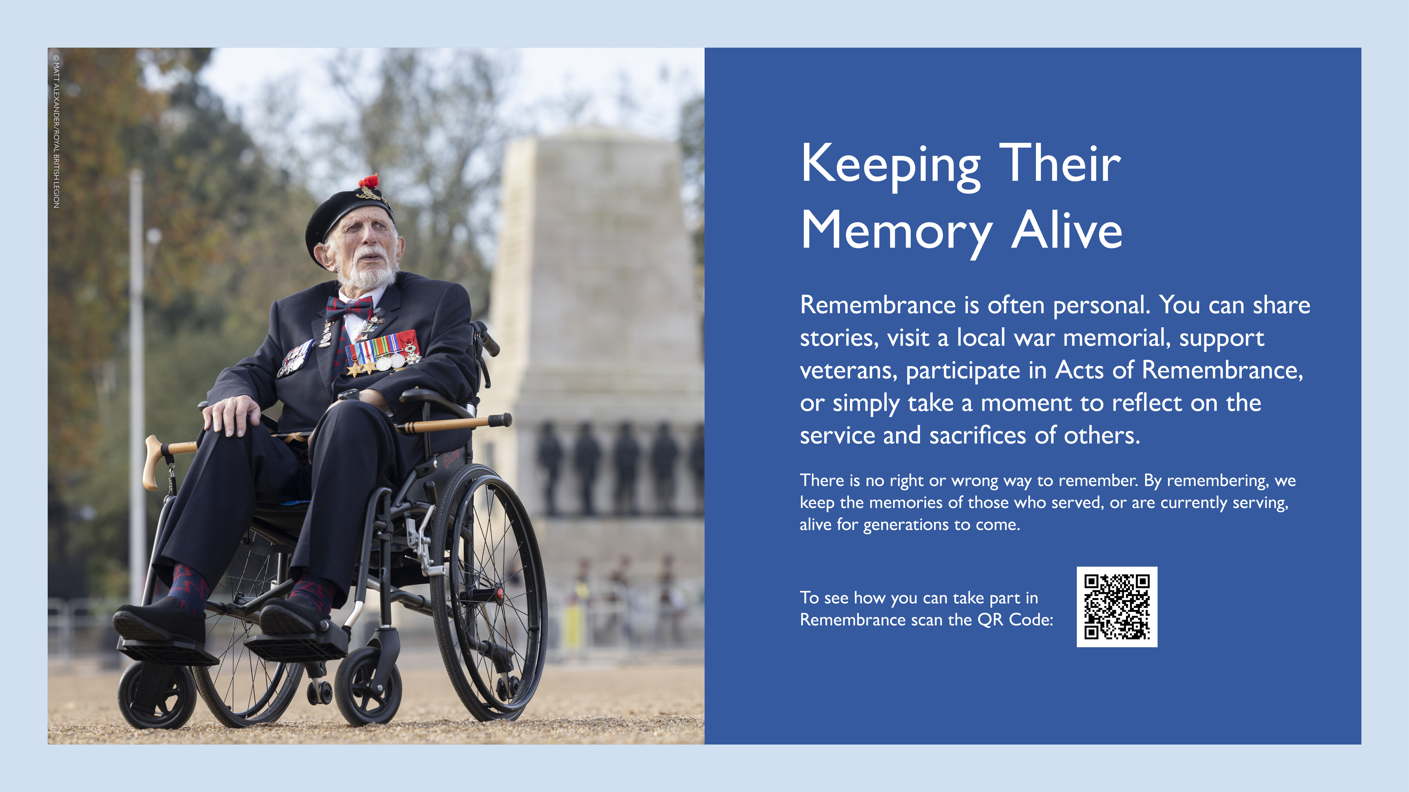
Notes:
Encourage personal reflection and participation in remembrance activities.
Explain the symbolism of the poppy and its connection to remembrance and hope.
Image: Joe Cattini - A World War Two Veteran at The Royal British Legion annual March Past The Cenotaph on Remembrance Sunday, 2022.

Slide 25
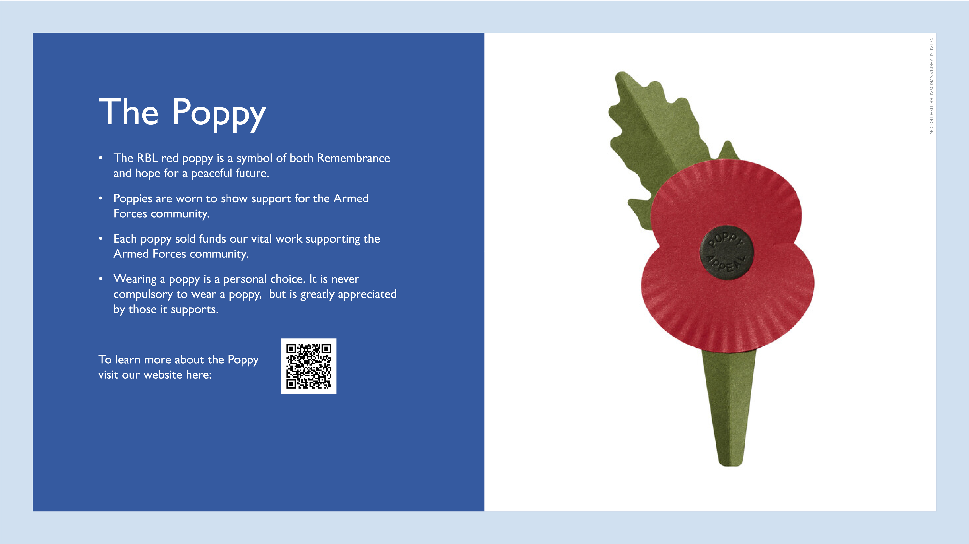
Notes:
Explain the symbolism of the poppy and its connection to remembrance and hope.
Mention the poppy's role in supporting the Armed Forces community.
Clarify that wearing a poppy is a personal choice.

Slide 26
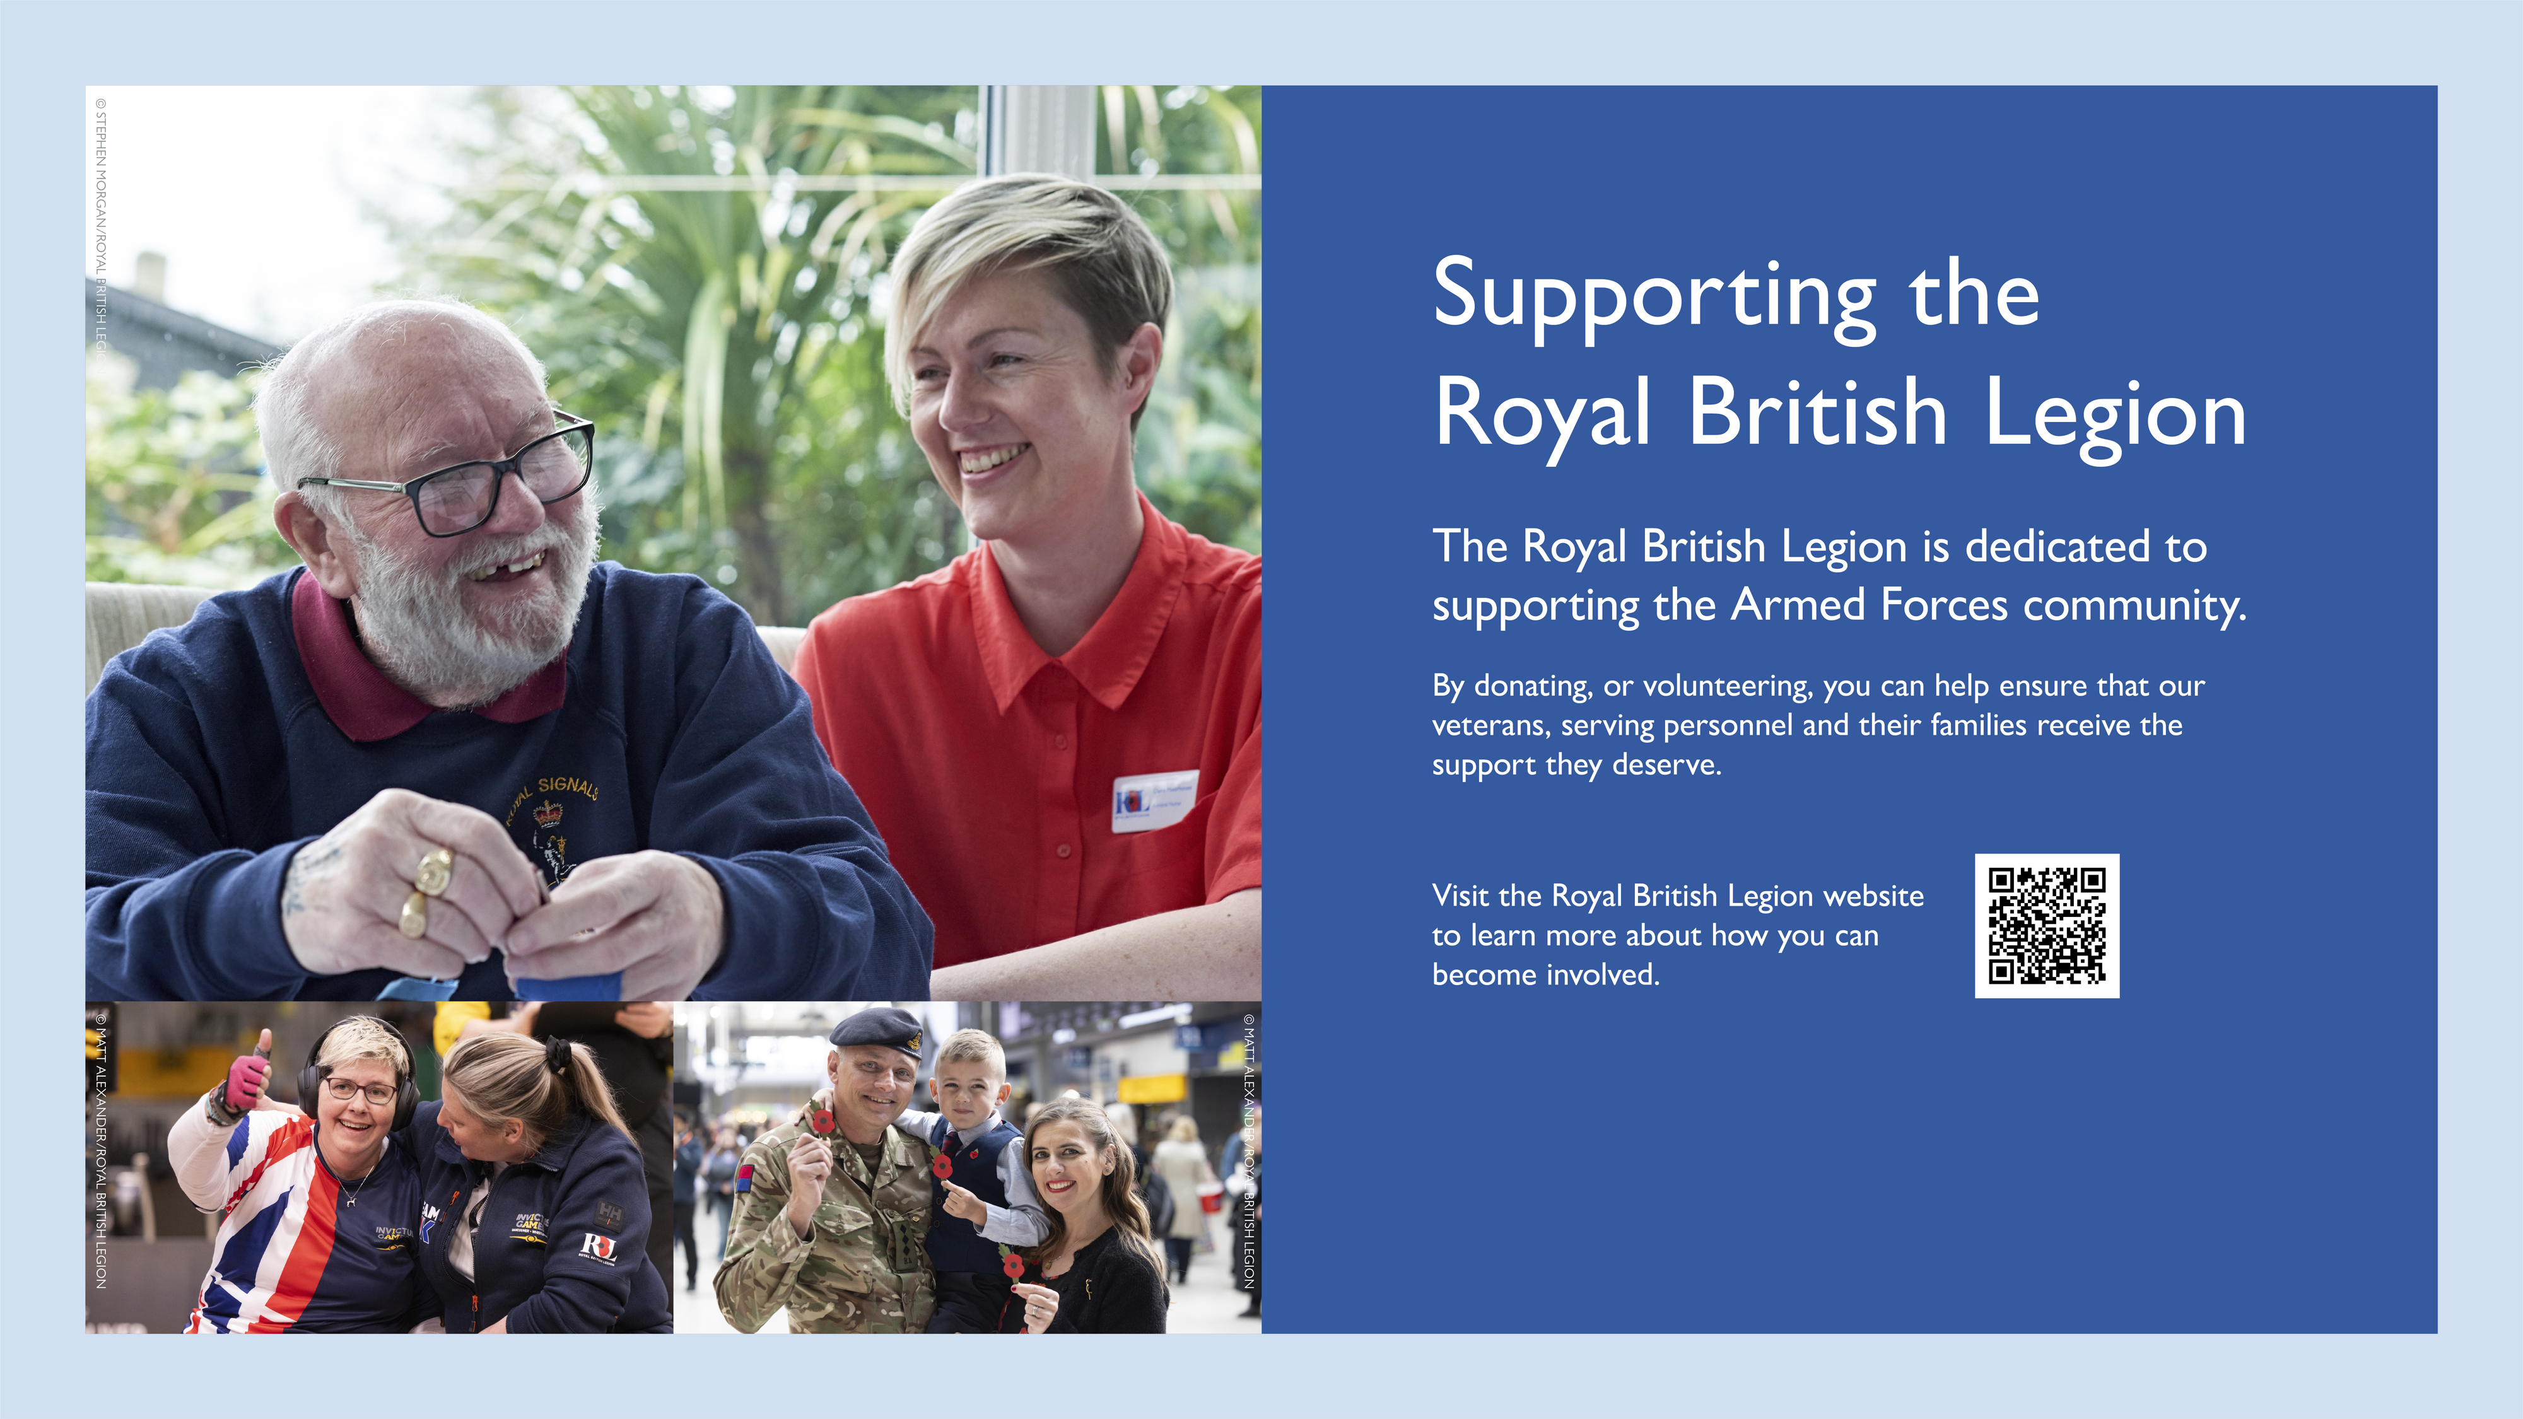
Notes:
Explain how this support benefits veterans, serving personnel, and their families.
Top Image: Brian Garner and Claire Moorhouse, Admiral Nurse. Bill has had a long career in the army. He joined at the age of 19 and was in the Army Cadets prior to that. He served in the Royal Signals for 36 years, retiring at the age of 55, at which point he was a Regimental Sergeant Major. He was diagnosed with Alzheimer’s disease in 2021.
Bottom Left Image: Sara Howarth and Alexandra McClellan from Team UK competing in Indoor Rowing at the Invictus Games, Vancouver, Canada on Sunday 16 February 2025.
Bottom Right Image: Captain Myles, British Army, Katie Myles and Son, volunteer collectors at London Poppy Day on 31 October 2024.

Slide 27

Notes:
Express gratitude to the audience for their time and attention.
Reiterate the importance of remembering the sacrifices made during the war.

