Slide 1
Remembrance - Forgotten Sacrifice

Slide 2
Forgotten Sacrifice
Remembrance
What is Remembrance?​
Remembrance is an act of honouring those who serve, or have served, to defend our democratic freedoms and way of life ​
Remembrance does not glorify war and its symbol, the red poppy, is a sign of both Remembrance and hope for a peaceful future.
Remembrance is not prescriptive and when we Remember we unite across faiths, cultures and backgrounds to remember the sacrifice of the Armed Forces community from Britain and the Commonwealth. ​
Who and what we Remember?
The service and sacrifice of the Armed Forces community from Britain and the Commonwealth
The special contribution of families and of the emergency services, and
We acknowledge innocent civilians who have lost their lives in conflict and acts of terrorism

Slide 3
Forgotten Sacrifice
Why do we remember?
Remembrance serves a number of important purposes:​
As thanks - It is a chance for individuals, communities and the nation to honour those who serve and sacrifice to defend our way of life and who gave their today for our tomorrow. ​
To bring communities together - Communities across Britain irrespective of religion, race or ethnicity share a history of service and sacrifice from the two World Wars through to the present day. Remembrance is a time to reflect on what we have in common. ​
To understand who we are - To understand modern Britain is to understand that it was built upon the service and sacrifice of millions of men and women from Britain and the Commonwealth during the two World Wars and in the rebuilding of the nation after them​.
To learn – As we remember the service and sacrifice of so many, who came from every walk of life and from every background, whether they served 100 years ago or today, the act of remembering reminds us that we must all continue to strive for a better and more peaceful future.

Slide 4
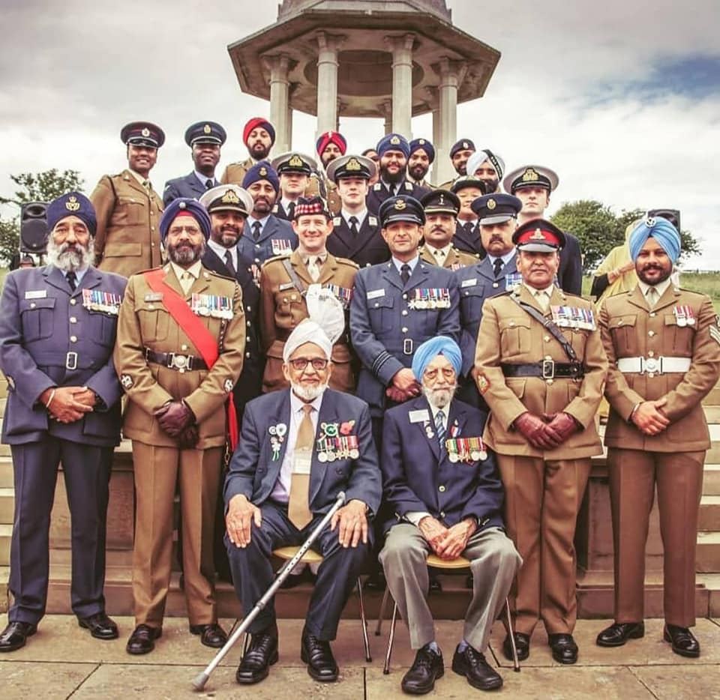
Forgotten Sacrifice
What is Forgotten Sacrifice?
In 2020 the Royal British Legion and British Future launched a project
with British Future called Forgotten Sacrifice, its purpose was to help
ensure that the service and sacrifice of people from communities
across Britain is recognised, that all feel able to take part in
Remembrance activities, and to ensure all who served are fully
recognised through better education, commemoration and
documentation of our shared history.
Men and women of different backgrounds, colours and creeds
came from across the Commonwealth have for over one hundred
years, played a crucial role in defending the freedoms we enjoy today.
The armies that fought in the Second World War were some of the
largest multi-ethnic forces in history, and many of those who served in
these forces would after the war settle in Britain playing a vital role in
rebuilding the country and establishing many of Britain's many diverse
communities.
Image from Defence Sikh Network UK

Slide 5
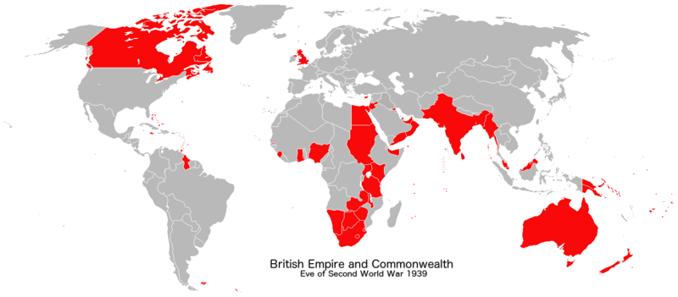
Forgotten Sacrifice
The Commonwealth in the Second World War
During the Second World War the total forces of Britain, the Commonwealth and the then British Empire totalled just over 12.6 million:
6.5 million came from the UK
Over 6.1 million came from the Commonwealth and Empire – in addition, the Commonwealth and Empire provided vast levels of financial and material support that were crucial to the Allied war effort.
The nations and territories that made up the British Empire and Commonwealth in 1939 can be seen below. When Britain went to war the people of the Empire and Commonwealth stood alongside Britain providing manpower, raw materials or both. Britain was never alone during the Second World War as millions rallied to Britain’s cause.
For a full list of nations and territories visit here

Slide 6
Forgotten Sacrifice
Forgotten Service from Africa, the Caribbean and South Asia Key Facts
Africa
Over a million men and women from what were European colonies across Africa were recruited, both voluntarily and forcibly, by European colonial powers to serve in combatant and non-combatant roles.
More than six hundred thousand black Africans fought for Britain.
African forces would fight in North and East Africa, Europe, the Middle East and Burma.
Caribbean
Approximately 12,000 men and women from the West Indies saw active service in the Royal Air Force serving as fighter pilots, air gunners, mechanics, ground staff and administrators.
Around 600 West Indian women were recruited for service in the Auxiliary Territorial Service (ATS), arriving in Britain in 1943, working as clerks, drivers and mechanics.
Thousands of West Indian seamen joined the Merchant Navy, carrying vital supplies across the Atlantic.
South Asia
The undivided Indian Army was by 1945 the largest volunteer army in history, made up of 2.5 million men and women who served on land, sea and in the air.
22 of the 34 Victoria Crosses won in the Burma Campaign were won by soldiers of South Asian origin - from undivided India (modern day India, Pakistan and Bangladesh), and Nepal.
It is estimated that undivided India’s entire output of timber, woollen textiles and leather goods, as well as three quarters of its steel and cement, were diverted to the defence of the British Empire. Making it next to Britain the largest contributor to the British, Commonwealth and Empire’s war effort.

Slide 7
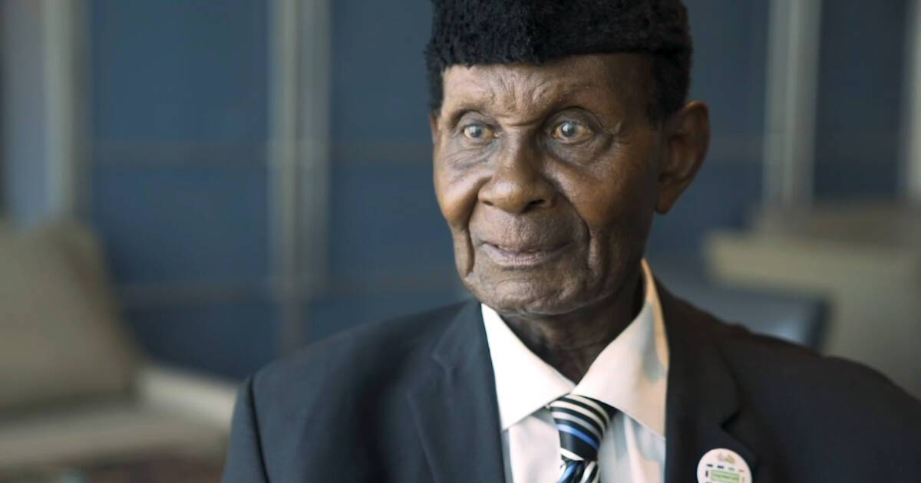
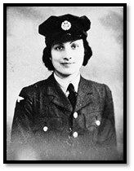
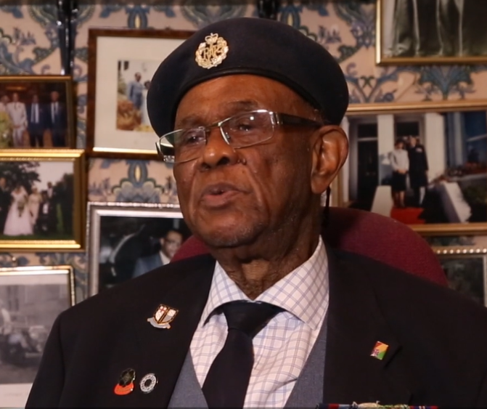
Forgotten Sacrifice
Stories of Service and Sacrifice
Below you will find are some short stories of service and sacrifice from men and women from Africa, the Caribbean and South Asia. The stories are of -
Private Joseph Hammond (b.1925),
Royal West African Frontier Force
Allan Wilmot (b.1925),
Royal Navy and Royal Air Force
Noor Inayat-Khan, (1914-1944),
Special Operations Executive

Slide 8
Forgotten Sacrifice
Stories of Service and Sacrifice
Private Joseph Hammond (b.1925), Royal West African Frontier Force
Born in Ghana in 1925, Joseph was still at school when war broke out, joining the army as soon as his studies were finished in July 1943.
In November 1943 Joseph would be part of 82nd West African Division, sent on to what was then Burma, to fight the Japanese Imperial Army. Joseph described the fighting, “It was terrible, because the Japanese they were the most ferocious human fighters that I have ever seen.”
Joseph and thousands of other African from East, Southern and West Africa would continue fighting across the jungles, swamps and rivers of Burma throughout 1944 and up until VJ Day in August 1945. In late 1944 after one of his eyes became contaminated and would be airlifted out of Burma back to undivided India where he would receive treatment until the wars end.
In 2020 Joseph was honoured by the Queen with the Commonwealth Point of Light award for his fundraising efforts. Inspired by Captain Tom Moore, Joseph walked two miles a day for a week in May, raising $35,000 (£28,000) so far to buy personal protection equipment for health workers and to protect vulnerable veterans on the African continent.

Slide 9
Forgotten Sacrifice
Stories of Service and Sacrifice
Allan Wilmot (b.1925), Royal Navy and Royal Air Force
Born in Jamaica, 1941 Allan volunteered for service in the Royal Navy at the age of sixteen.
Allan was trained on HMS Hauken, a minesweeper which patrolled and escorted convoys of ships heading to the Panama Canal. In 1942 the SS Empire Beatrice, an unescorted and unarmed cargo ship was sunk by a German U-boat that had positioned themselves in the Caribbean Sea with the aim to sink as many Allied ships carrying oil and other materials as they could. The Hauken rescued nine survivors. Allan was only one of six Jamaicans and the only black sailor serving on the Hauken.
In late 1943 Allan joined the RAF Air-Sea Rescue Service, an elite force that specialised in rescuing downed aircraft. Arriving in Liverpool in July 1944 he was stationed at RAF Calshot (near Southampton) that specialised in rescuing airman who had been shot down in the English Channel. The only black serviceman in a crew of 15, Wilmot was part of the service that saved the lives of over 14,000 air crew.
After the war, Allan returned to Jamaica a leading aircraftman. He returned to Britain in December 1947 and had a successful career in showbusiness, performing as part of the Southlanders all over Britain and Europe, sharing billing with some of the most famous acts of the late 1940s and 50s.

Slide 10
Forgotten Sacrifice
Stories of Service and Sacrifice
Noor Inayat-Khan, (1914-1944), Special Operations Executive, awarded the George Cross and Croix de Guerre
Born in Moscow, the eldest of four children. Her father came from a noble Indian Muslim family and her mother was an American from Albuquerque, New Mexico.
Her family moved to France before the start of First World War and then to Britain in 1940, and in November of the same year aged 26 Noor joined the Women’s Auxiliary Air Force (WAAF)
In 1942 she was recruited by the Special Operations Executive (SOE) F (French) section due to her wireless and language skills.
Noor became the first female radio operator to be sent to France by the SOE. Codenamed ‘Madeleine’, she landed in France on the night of 16th/17th June 1943 and made her way to Paris to work as part of the ‘Cinema’ resistance network.
Betrayed by a fellow SOE agent she was captured on the 1st October 1943. She was transferred to Pforzheim prison in Germany as she regularly made efforts to escape. Kept in solitary confinement and likely subject to torture, Noor still gave nothing away.
On the 13th September 1944 Noor was moved to Dachau Concentration Camp with three other female SOE agents, and executed. A Dutch prisoner later said that Noor’s last words were “Liberte”.
She was posthumously awarded the George Cross, one of only three women in history to receive such an accolade, along with the Croix de Guerre by France.

Slide 11
Forgotten Sacrifice
Remembering the Forgotten
Today there are many organisations that have sought to address the many veterans who have felt forgotten, and to ensure the service and sacrifice of all is remembered, such as:
The Kohima Educational Trust
Help for Forgotten Allies
Royal Commonwealth Ex-Servicemen’s League
The Commonwealth War Graves Commission
The Not Forgotten Association
COFEPOW – The Children (& Families) of the Far East Prisoners of War
There are also many regimental or campaign associations that seek to highlight the role played by all, for example
The King’s African Rifles and East African Forces Association
The Italy Star Association
The Burma Star Association
The Indian Army Ex-Servicemen’s Association
The West Indian Association of Service Personnel

Slide 12
Forgotten Sacrifice
How to get involved
Help us remember all those whose stories have been forgotten or have yet to be told,
Browse our collection of film stories here and share them with your friends, colleagues, and families.
View more stories from the RBL on the South Asian Heritage Month and Black History Month websites.
Share these stories through your social media platforms and shine a light on forgotten sacrifices.
Find out more about your own family’s or community’s history of service and sacrifice on the Nation Archives or Forces War Records websites.
Find out more about the role of British and Commonwealth forces during the Second World War by looking at the Royal British Legion’s VE Day and VJ Day webpages
Explore our free to download learning resources for parents and teachers and share the many stories of men and women from across Britain and the Commonwealth who served and sacrificed

Slide 13
Forgotten Sacrifice

