Slide 1
100 Years of Remembrance

Slide 2
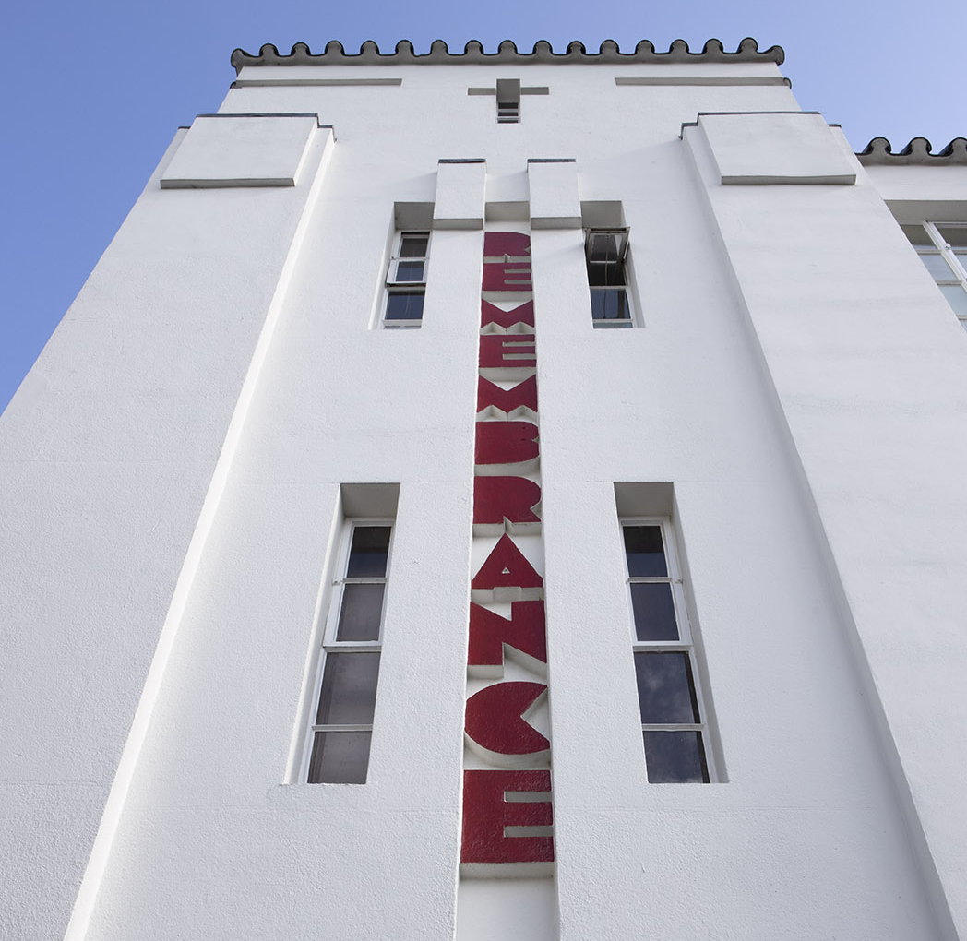
100 Years of Remembrance
Remembrance
What is Remembrance?​
Remembrance honours those who serve to defend our democratic freedoms and way of life. ​
We unite across faiths, cultures and backgrounds to remember the sacrifice of the Armed Forces community from Britain and the Commonwealth.
​
Who do we remember?​
We pay tribute to the special contribution of families, as well as the emergency services. ​
And we acknowledge those innocent civilians who have lost their lives in conflict and acts of terrorism.

Slide 3
100 Years of Remembrance
Why do we remember?
Remembrance serves a number of important purposes:​
As thanks - It is a chance for individuals, communities and the nation to honour those who serve and sacrifice to defend our way of life and who gave their today for our tomorrow. ​
To bring communities together - Communities across Britain irrespective of religion, race or ethnicity share a history of service and sacrifice from the two World Wars through to the present day. Remembrance is a time to reflect on what we have in common. ​
To understand who we are - To understand modern Britain is to understand that it was built upon the service and sacrifice of millions of men and women from Britain and the Commonwealth during the two World Wars and in the rebuilding of the nation after them​.
To learn – As we remember the service and sacrifice of so many, who came from every walk of life and from every background, whether they served 100 years ago or today, the act of remembering reminds us that we must all continue to strive for a better and more peaceful future.

Slide 4
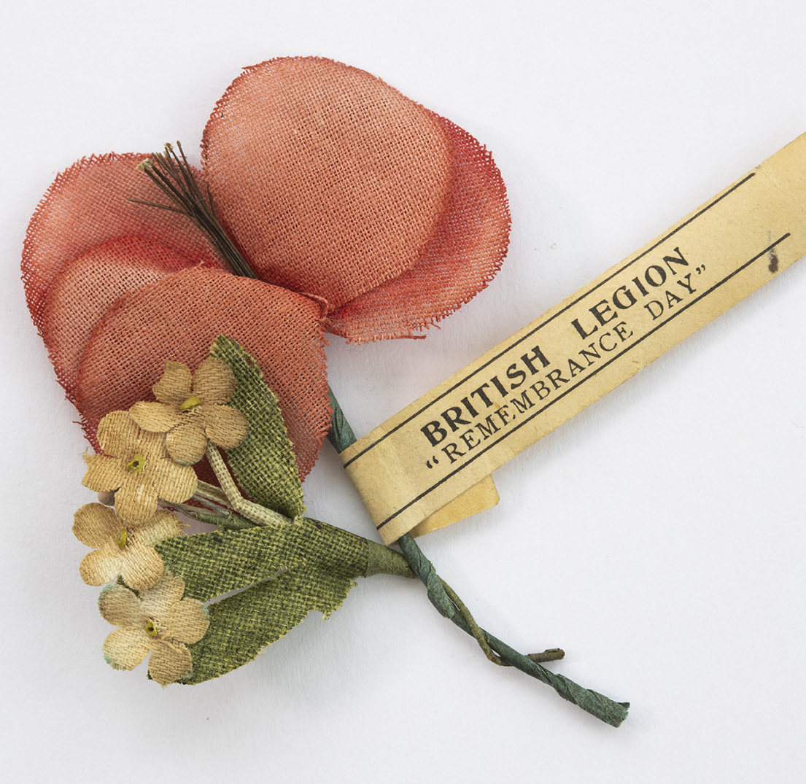
100 Years of Remembrance
The beginnings
During the First World War almost every household was affected by the loss of a close family member or a friend in the community.
Out of this shared experience came many of the traditions of Remembrance we know today - war memorials honouring all regardless of rank, the National Service of Remembrance at the Cenotaph, Remembrance parades, Two Minute Silence, and the poppy.
In 2021 we mark 100 years of Remembrance and look ahead to 100 years more.

Slide 5
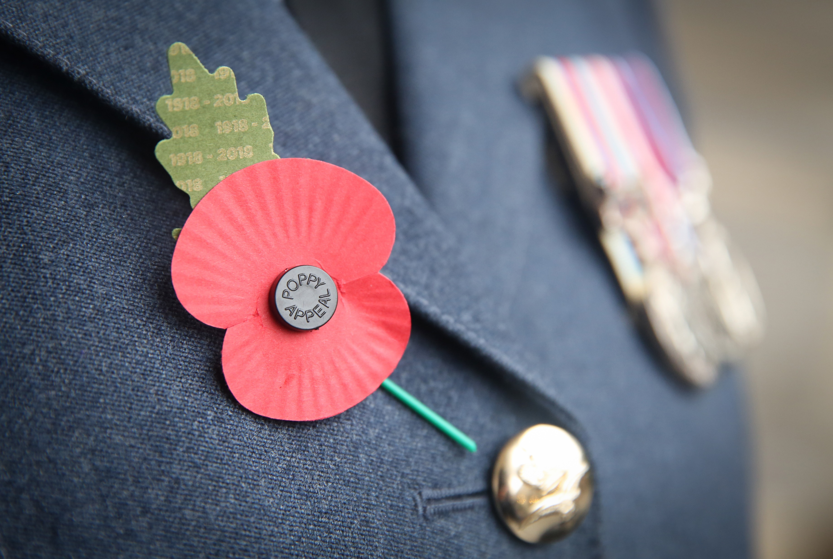
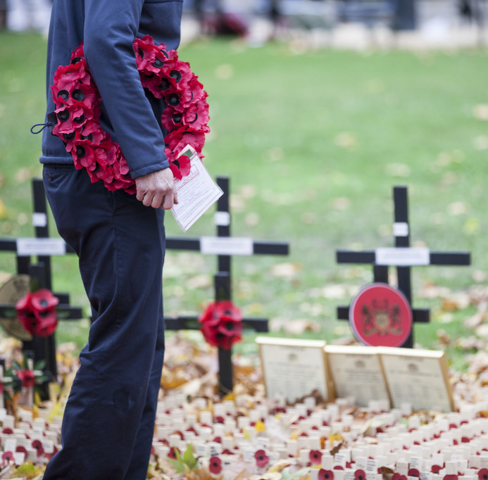
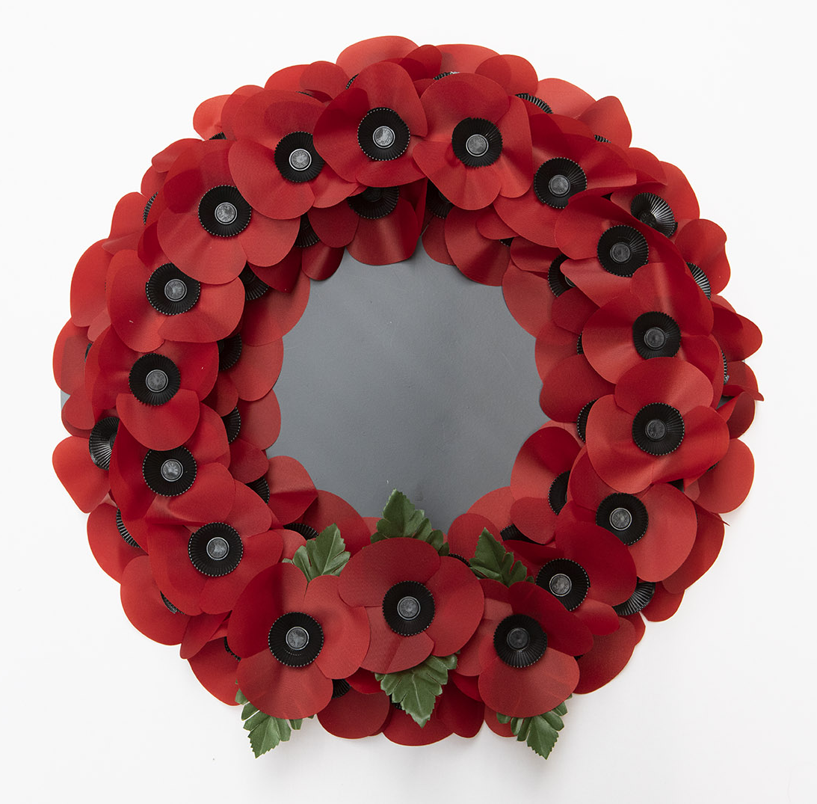
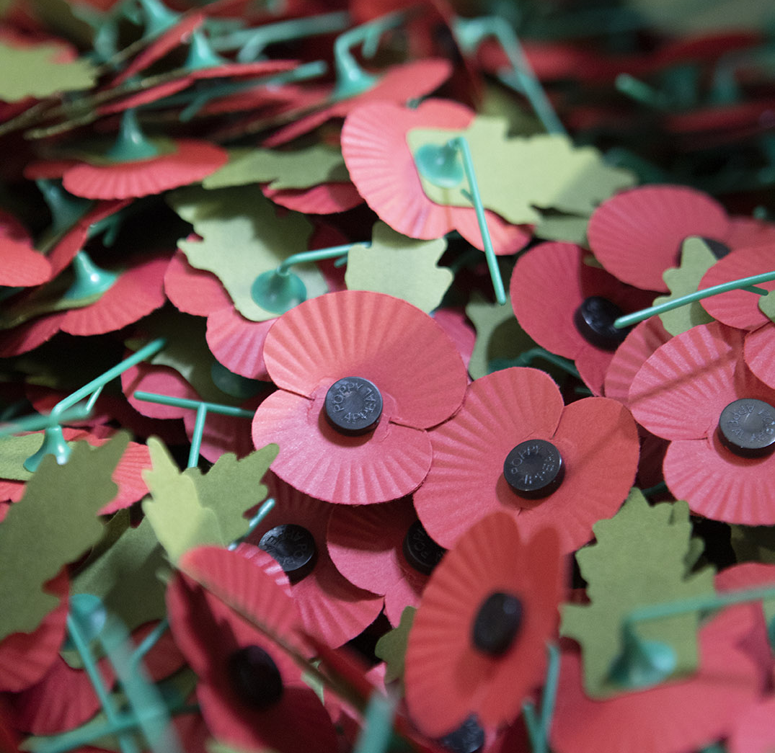
100 Years of Remembrance
How do we remember?
Remembrance means different things to different people.
For some it’s about observing traditional elements of Remembrance such as the Two Minute Silence and the laying of wreaths.
But over the years, and across different cultures and communities, Remembrance is evolving.
Remembrance now takes many forms and means something different to everyone. It can be a collective act or something deeply personal.

Slide 6
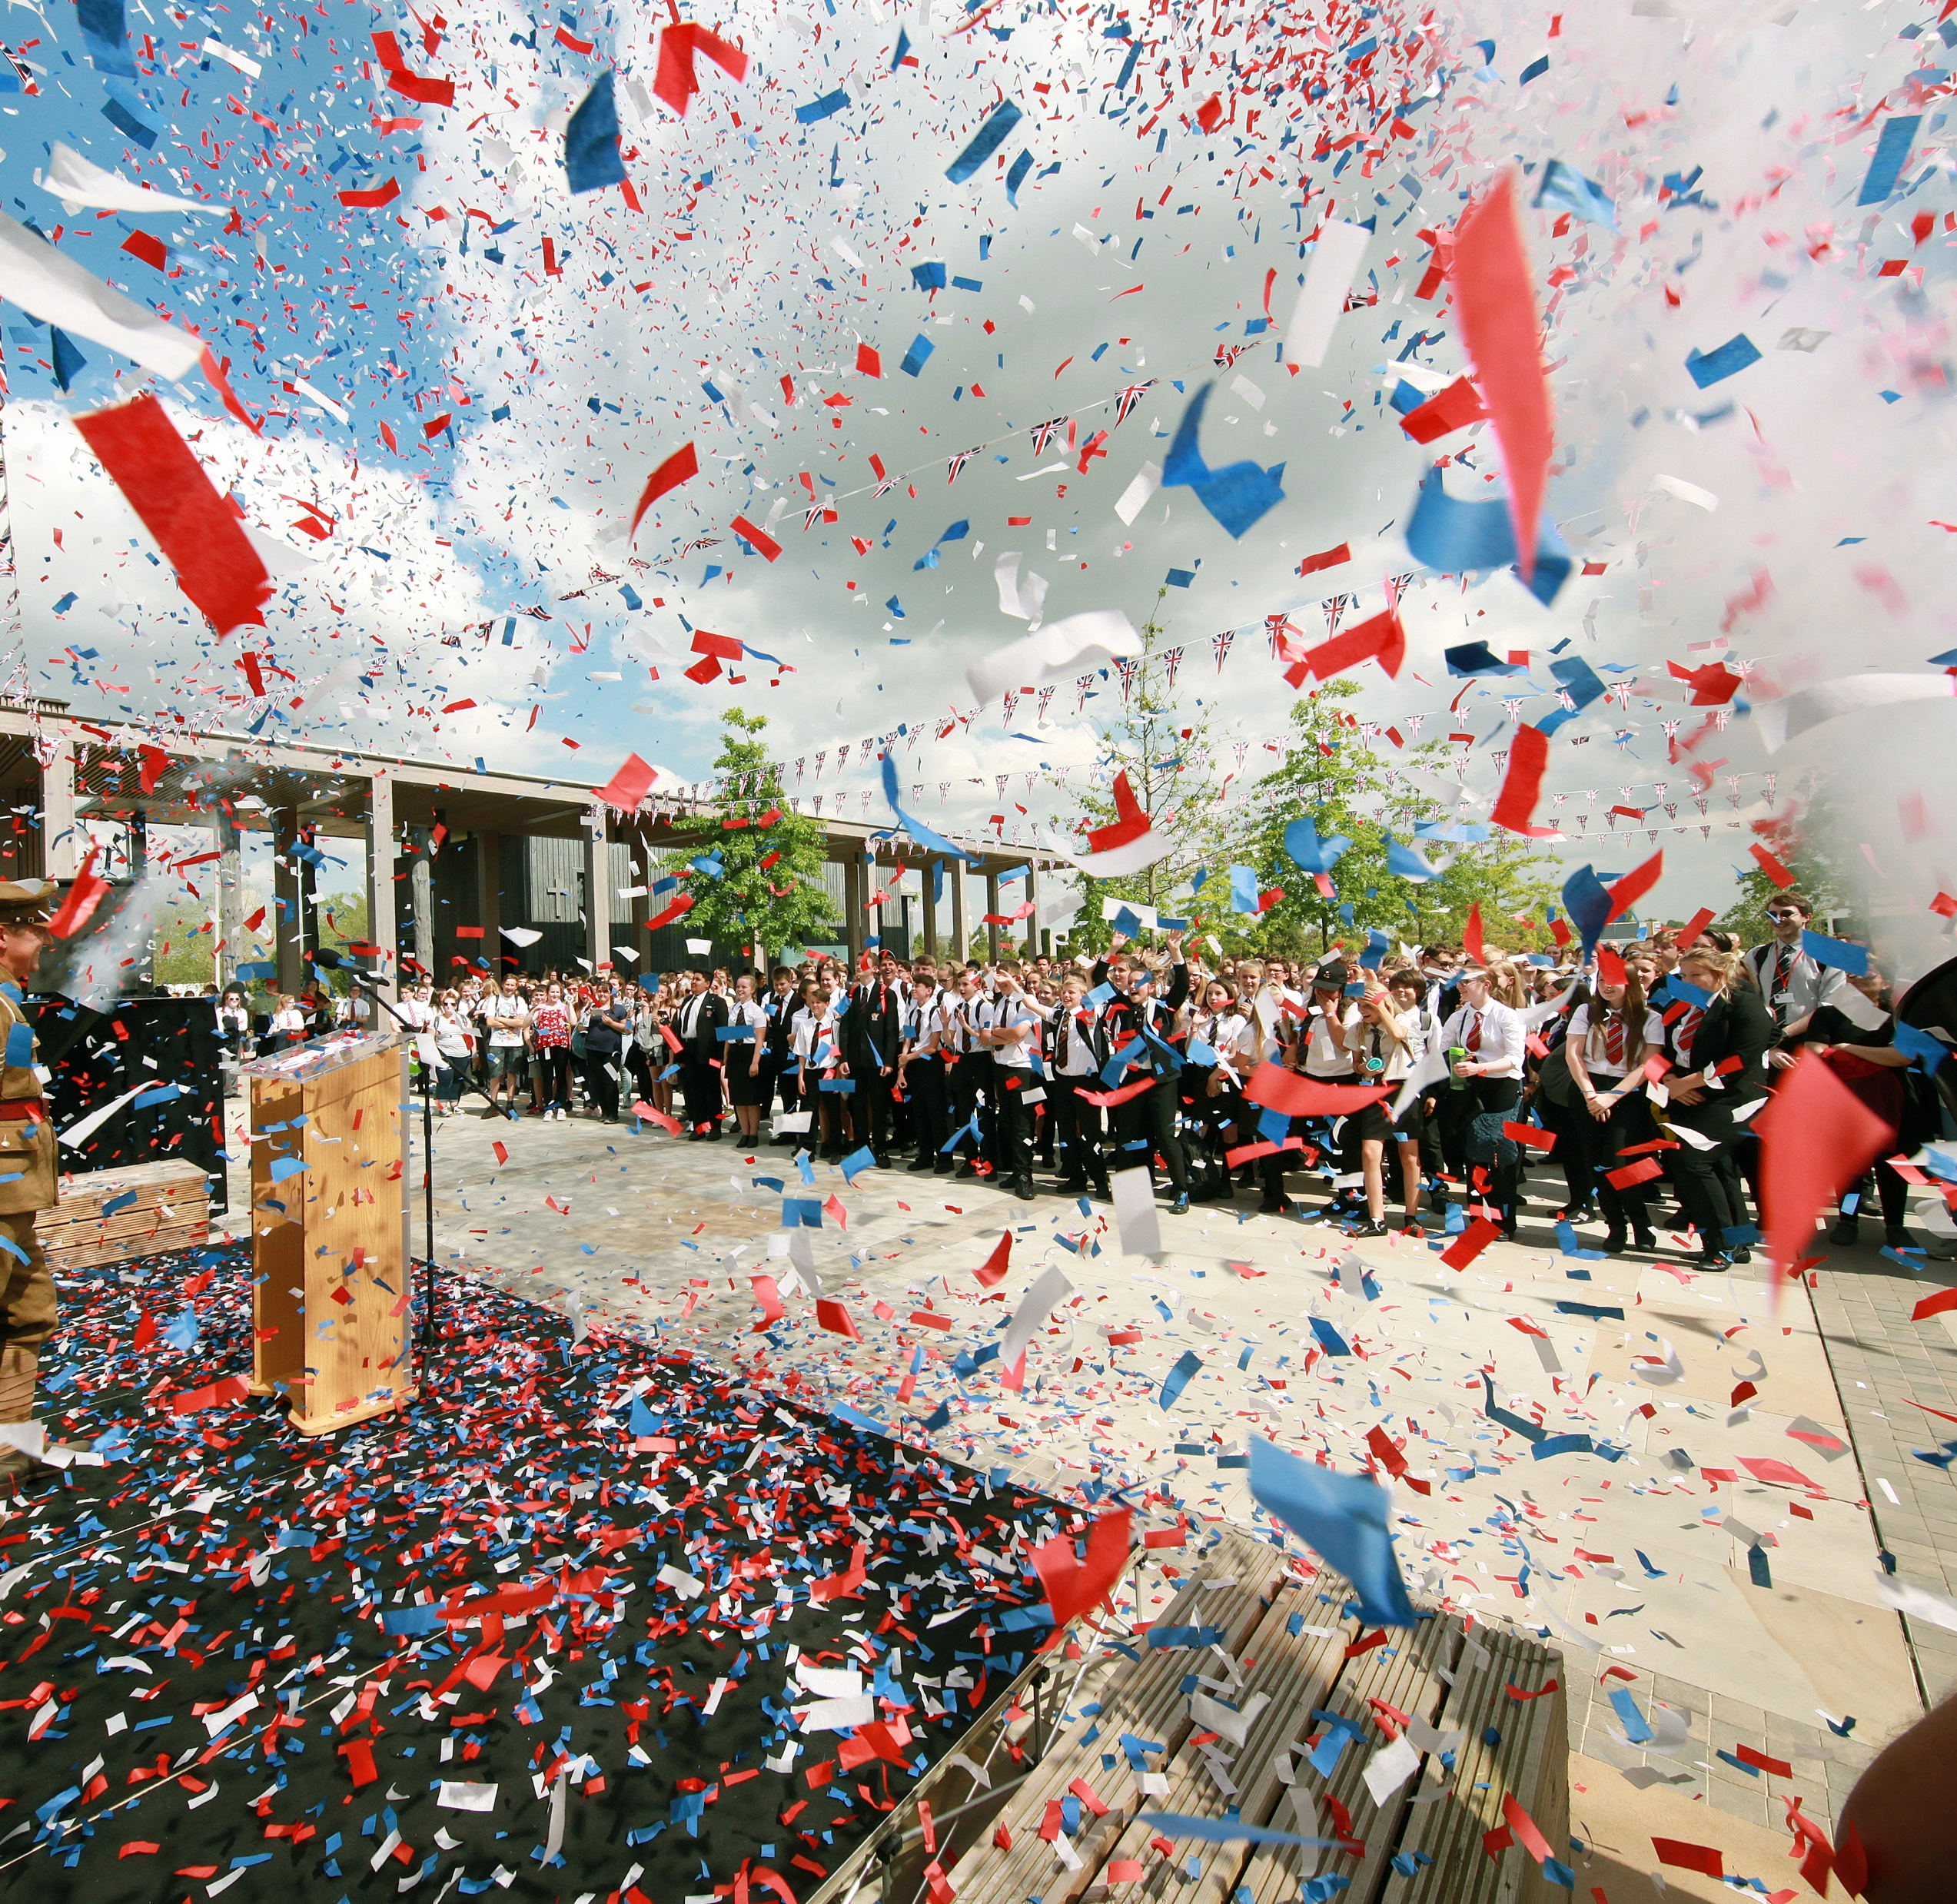
100 Years of Remembrance
The future of Remembrance
As we look to the next 100 years of Remembrance our aim is to empower people to find new ways to remember those who have served.
While remaining respectful of traditional Remembrance activities we want to give all communities the freedom to develop their own forms of Remembrance which reflect their own histories and cultures.
We also want to inspire the activity of Remembrance, not just on 11 November, but as a year-round activity that people can partake in when they want, and in a way they see fit.

Slide 7
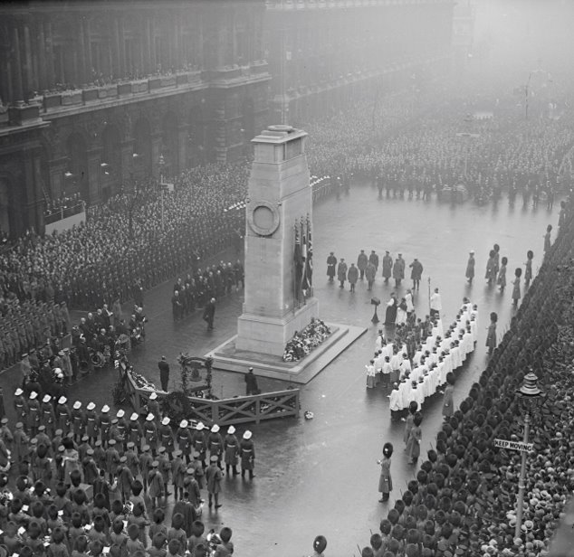
100 Years of Remembrance
National Service of Remembrance
The National Service of Remembrance is held at the Cenotaph in London on Remembrance Sunday and has changed little since it began.
This service is reflected across the country with communities gathering in public spaces and at local memorials to observe the Two Minute Silence, lay wreaths and remember the service and sacrifice of those who served in the World Wars and those who serve today.
Is there a Remembrance Service in your community? How could you get involved or encourage others to do so?

Slide 8
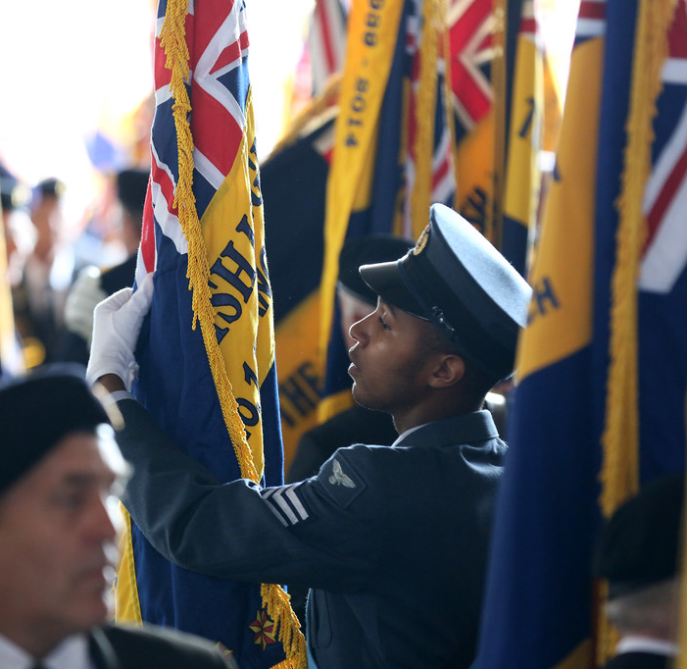
100 Years of Remembrance
Pilgrimages
For some a pilgrimage to a battlefield, cemetery or other special place is the way the remember and feel a connection to the past.
The Great Pilgrimage in 1928 saw 11,000 veterans and widows travel to France and Belgium to visit the battlefields and cemeteries of the First World War.
And Normandy, where the D-Day landings took place, are popular with families and veterans alike. They visit the beaches, memorials and museums to remember all that took place there and the sacrifice made by so many.
Have you taken part in a pilgrimage? Maybe you could share what it meant to you with others in your community.

Slide 9
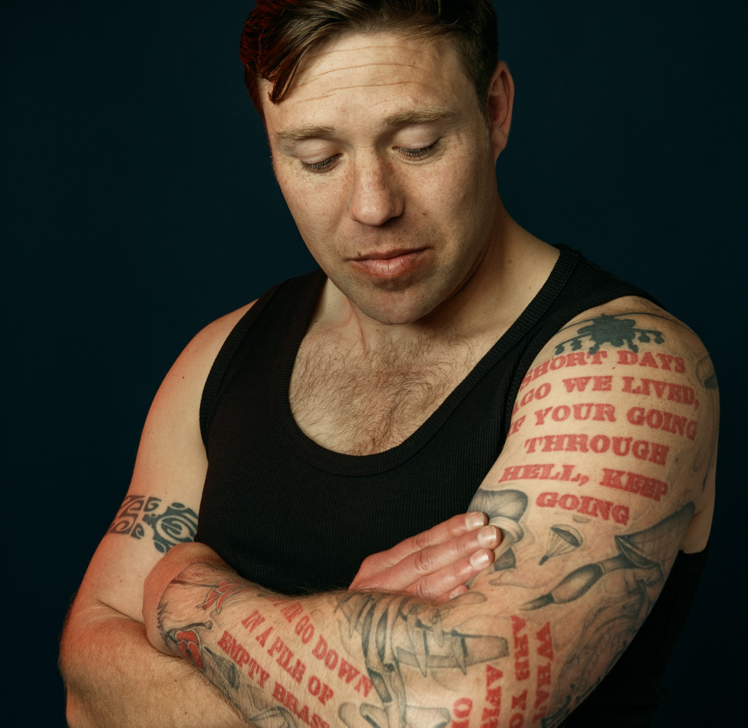
100 Years of Remembrance
Tattoos and Remembrance
Tattoos are a significant and permanent act of Remembrance in the British Armed Forces. Inked onto the skin, they mark the lasting bonds formed between men and women who live, train and serve together.
Military tattoos are full of meaning and symbolism, telling stories of personal sacrifice, Remembrance and belonging.
Tattoos are also used to remember loved ones outside of the military.
The RBL’s Tribute Ink exhibition highlights the importance of tattoos in Remembrance. You can find out more on our website: https://www.britishlegion.org.uk/get-involved/remembrance/tribute-ink

Slide 10
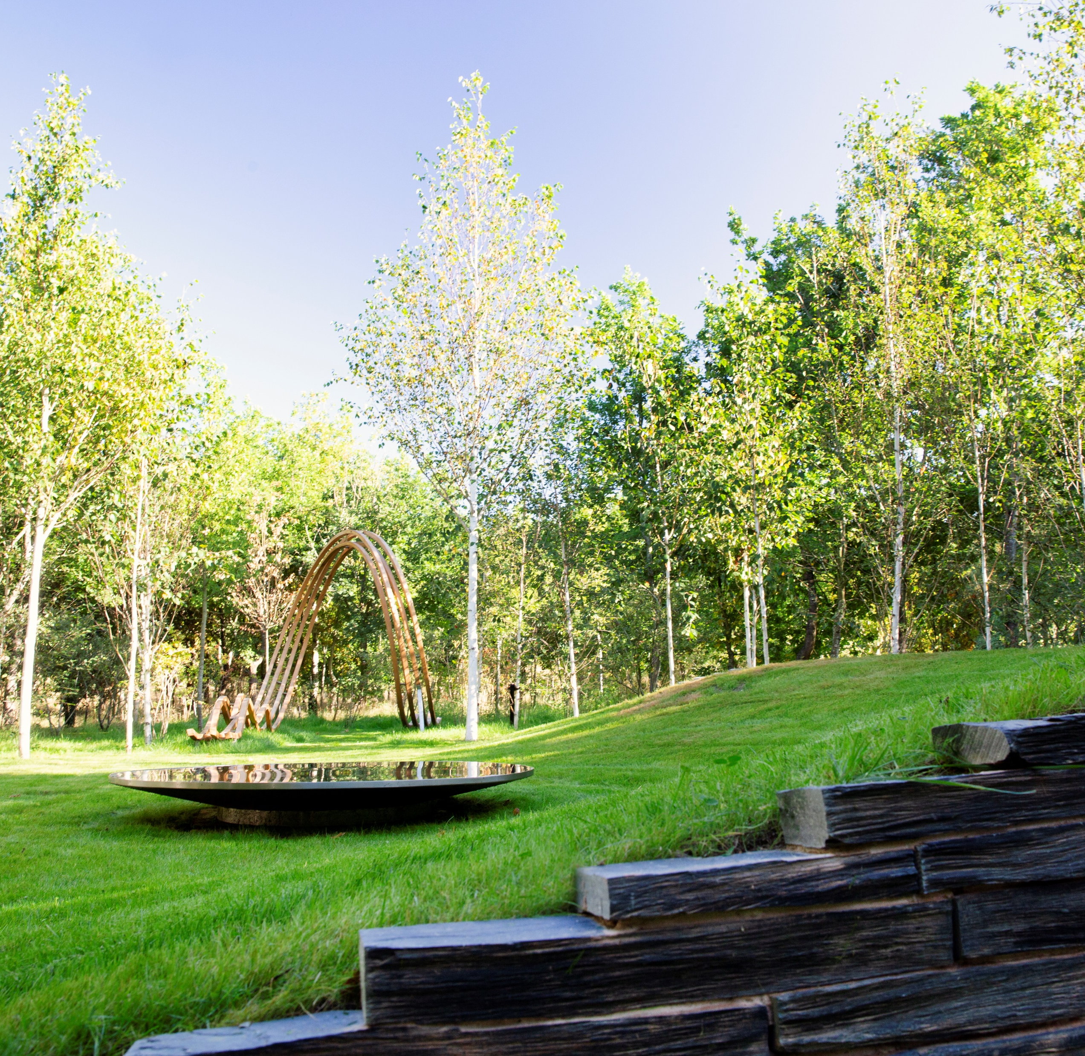
100 Years of Remembrance
Trees and plants
Green space provides a setting for quiet contemplation and reflection in Remembrance.
The trees and plants chosen can be symbolic or can be a physical reminder of a person or event, and a planted space gives people a place to visit and Remember.
Once created, planted Remembrance spaces can live forever.
Can you think of a place where you could create a planted Remembrance space? This could be in the community, your garden or even a window box.

Slide 11
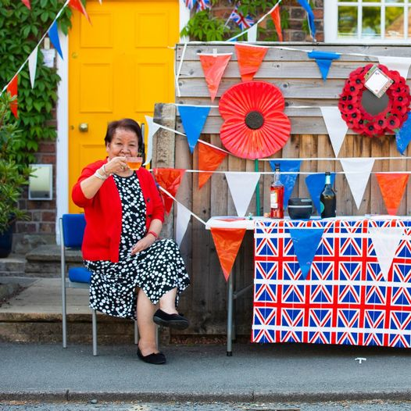
100 Years of Remembrance
Celebration
Remembrance doesn’t have to be a solemn and sombre act.
Some cultures remember those they have lost with colourful celebrations, music and dancing.
The RBL’s annual Festival of Remembrance has previously featured community singing with all in attendance joining in to sing songs together.
You could arrange a community celebration of Remembrance. Sharing music, food and stories together while remembering those who have served and sacrificed.

Slide 12
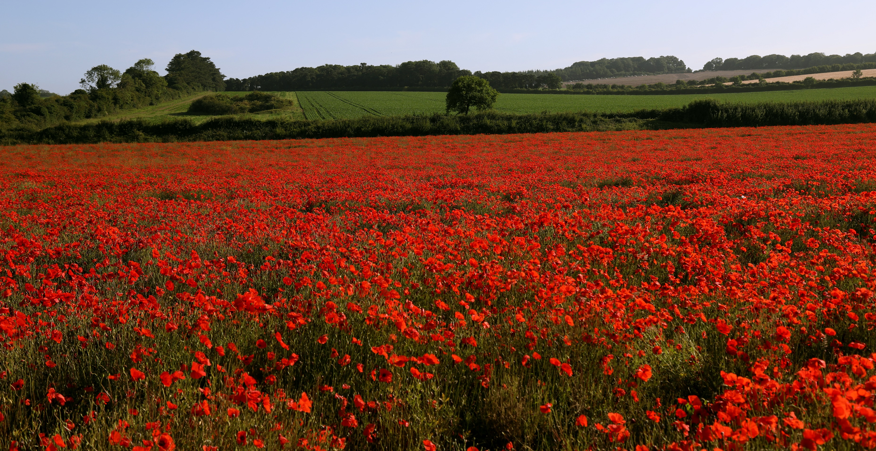
100 Years of Remembrance

